Slide 1
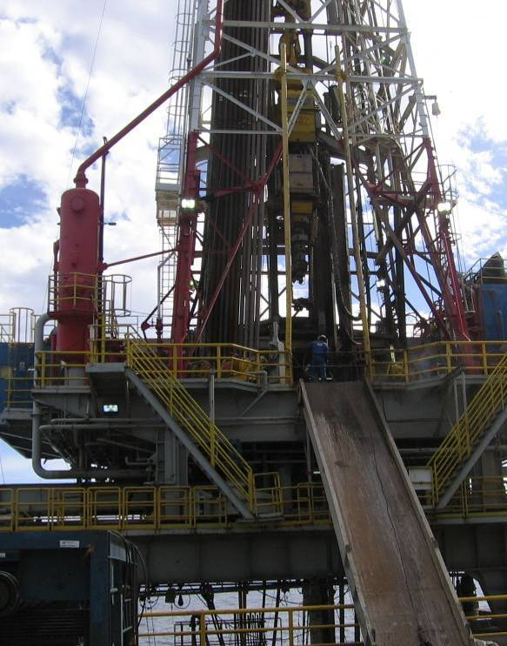
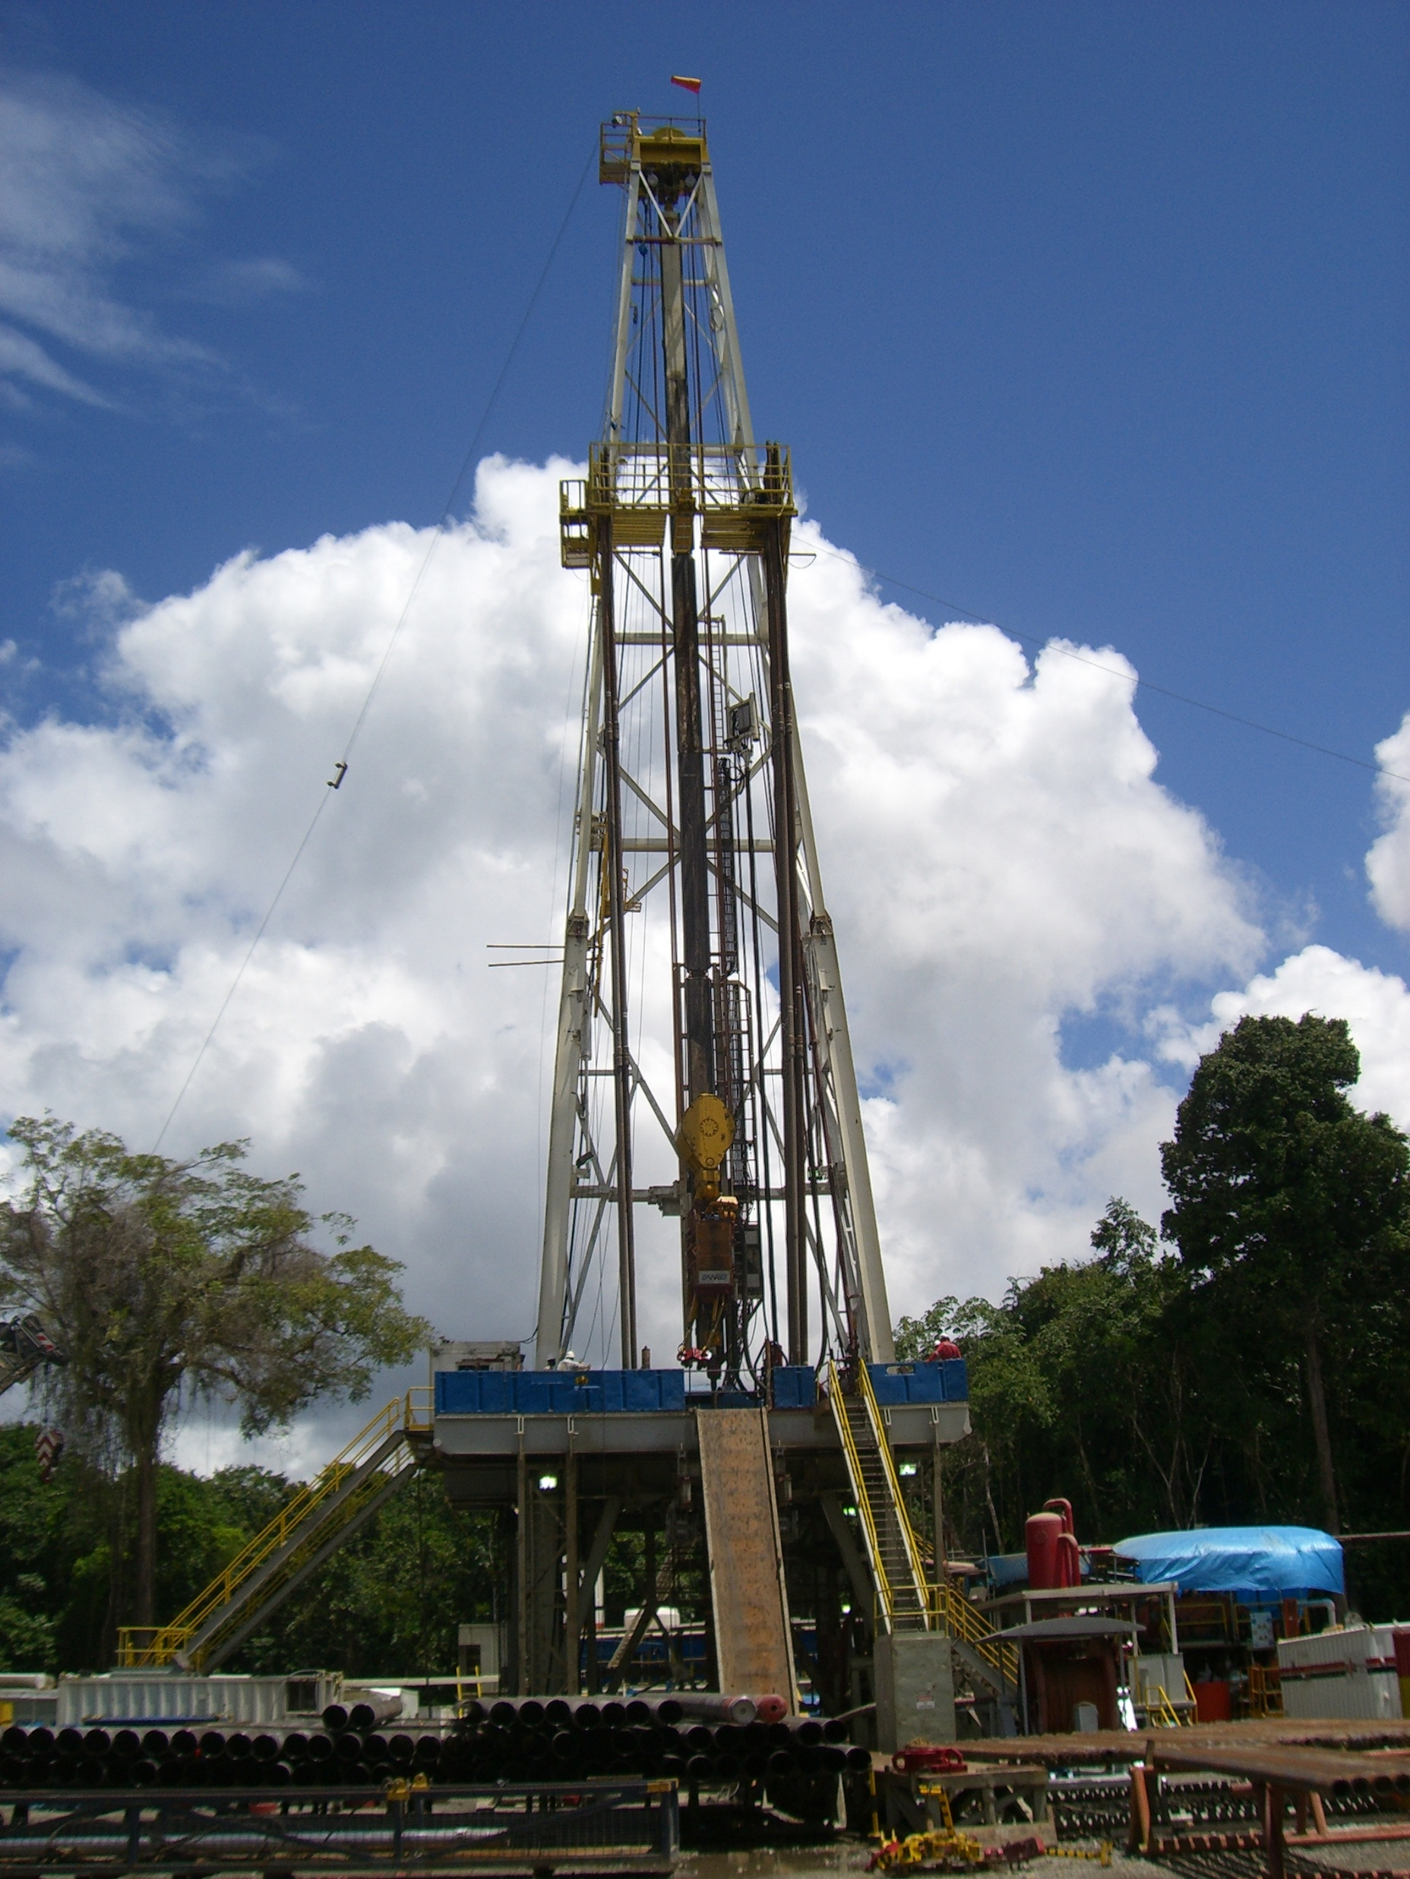

Rig Learning
for the
Roustabout
ZENVORA GROUP OF INSTITUTIONS

Slide 2
RigLearning OJT Program
TRAINING ELEMENTS FOR THE ROUSTABOUT
Basic Drilling
Emergency Situations
Safety Management System
Health, Safety, Environment
Surface Preparation and Painting
Cranes
Slings
Supply Boats
Tools
Tuggers
Tubulars
Catwalks
Confined Space
Mud System
Relieving on the Floor
Remember: Every Injury is Preventable!

Slide 3
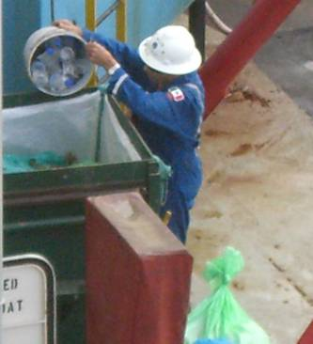
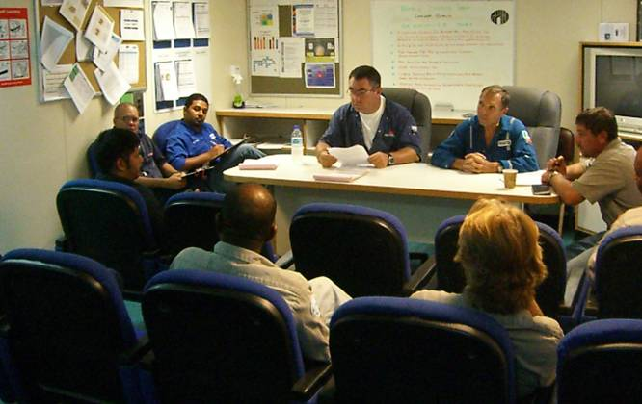
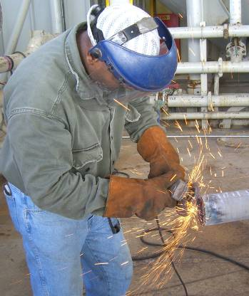
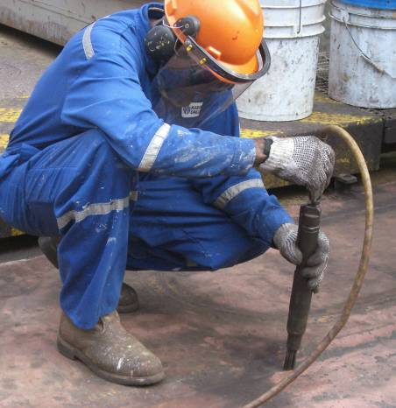
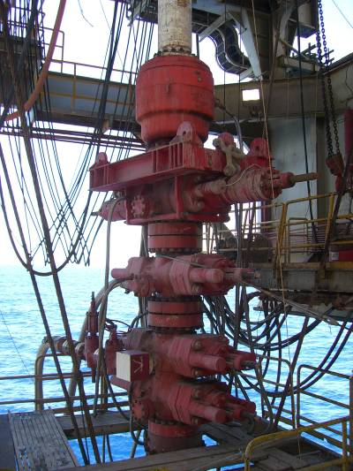
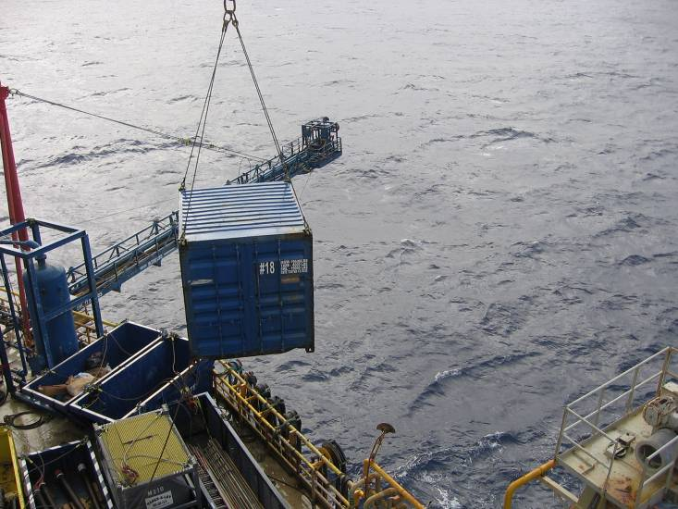
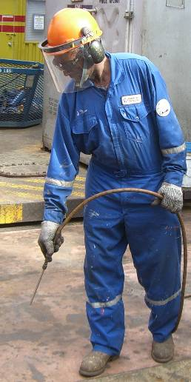
ROUSTABOUT OJT HANDBOOK
TYPICAL JOBS AND ACTIVITIES FOR THE ROUSTABOUT ON THE RIG
WASTE DISPOSAL
MEETINGS
WORKING WITH WELDER
NEEDLE GUN
RIGGING BOP
MOVING LOADS
CLEANING

Slide 4
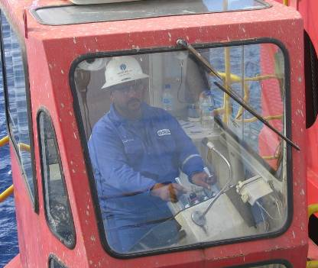
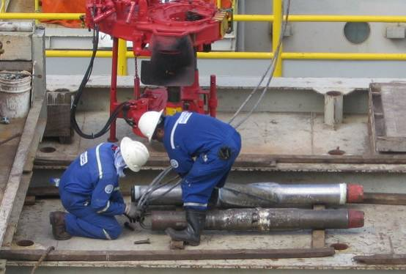
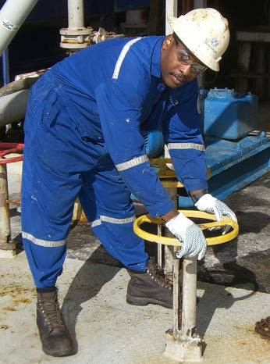
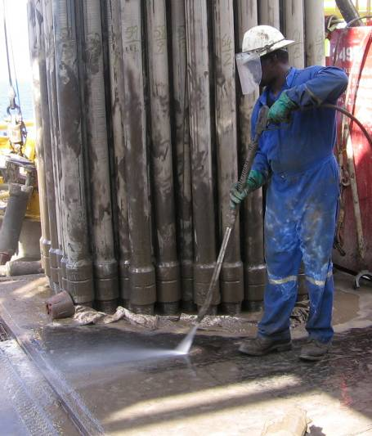
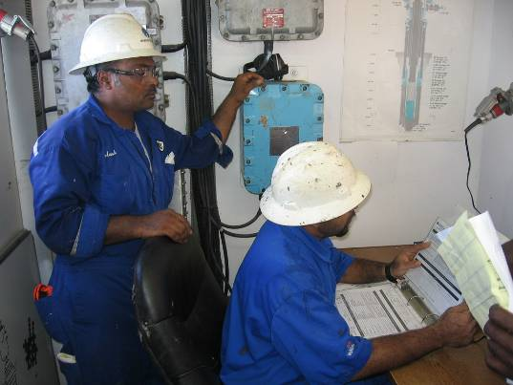
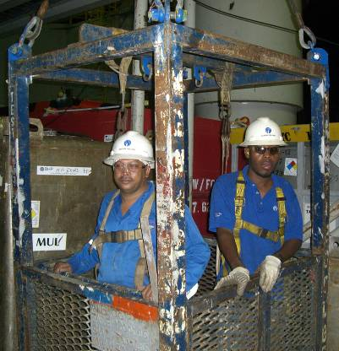
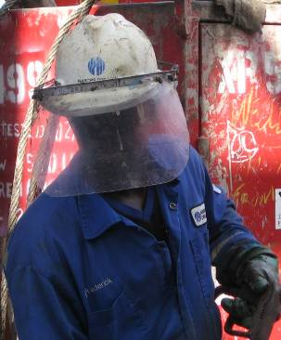
ROUSTABOUT OJT HANDBOOK
TYPICAL JOBS AND ACTIVITIES FOR THE ROUSTABOUT ON THE RIG
WORKING WITH CRANE OPERATOR
PREPARING A LOAD
CLOSING VALVES
WASHING
WEARING PROPER PPE
DOING JSA’S
WORK BASKET

Slide 5
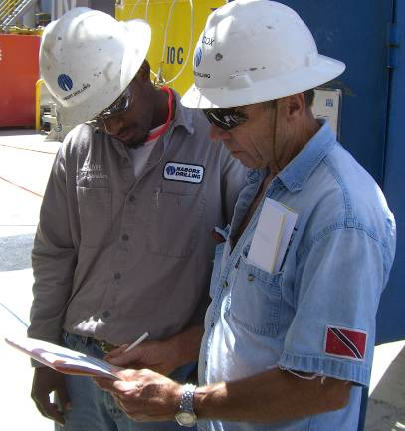
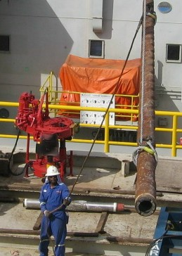
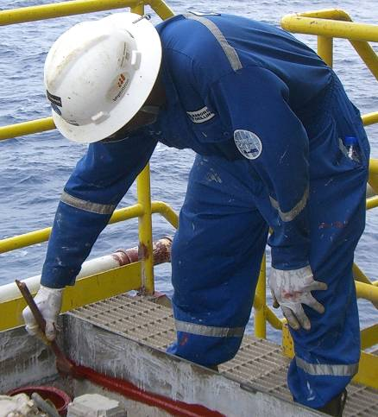
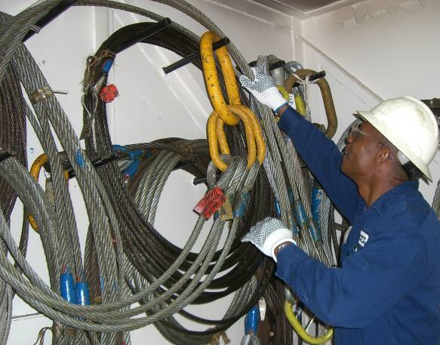
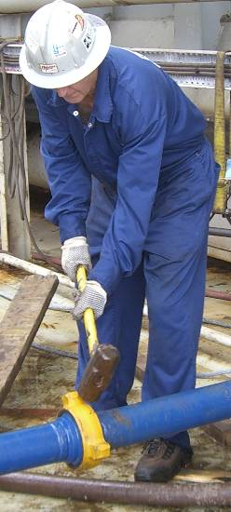
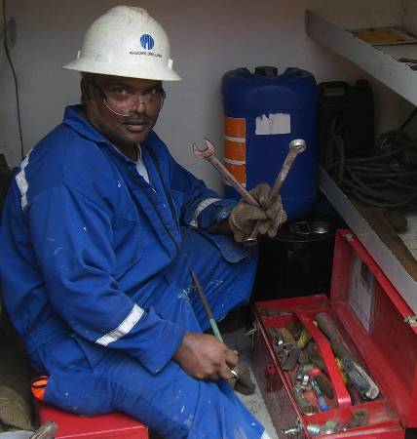
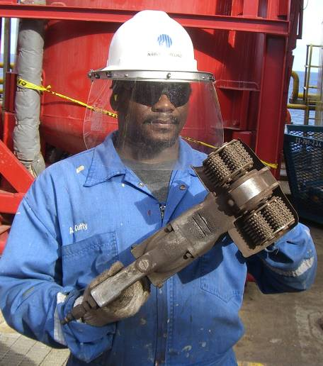
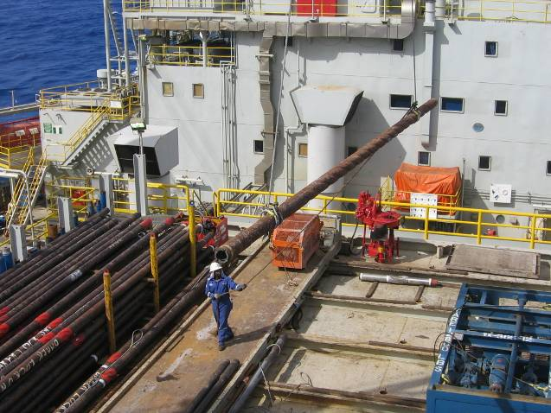
ROUSTABOUT OJT HANDBOOK
TYPICAL JOBS AND ACTIVITIES FOR THE ROUSTABOUT ON THE RIG
PLANNING
STORING SLINGS
PAINTING
HANDLING LOADS
USING WRENCHES
HAMMERING
WORKING WITH CRANE
CHIPPERS

Slide 6
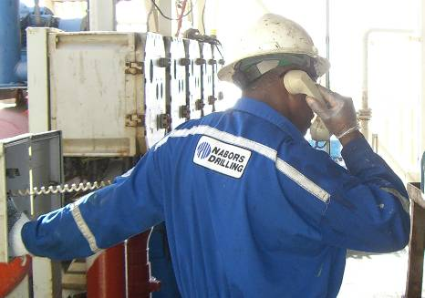
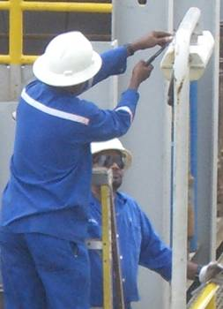
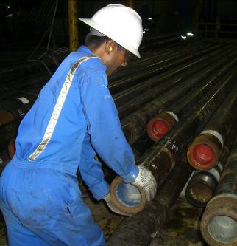
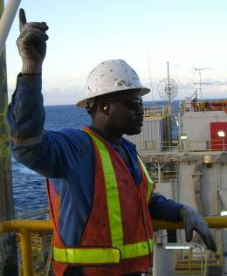
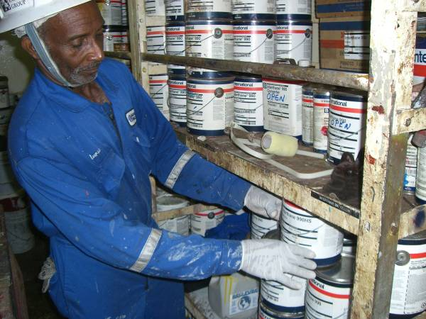
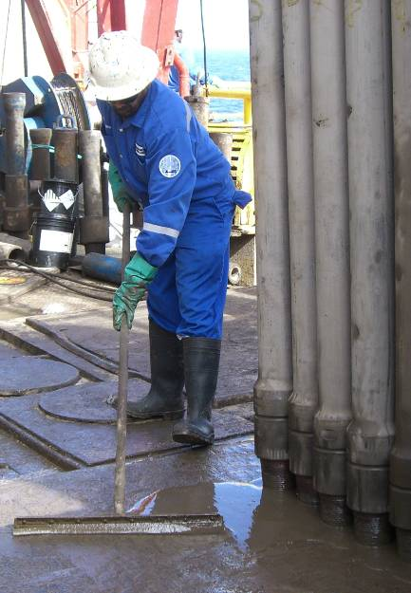
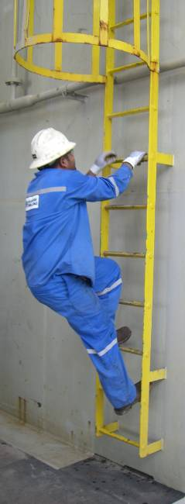
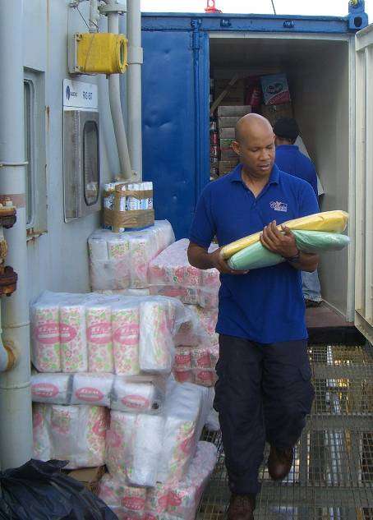
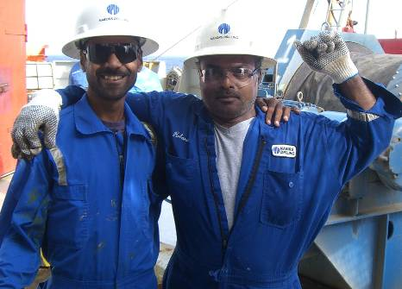
ROUSTABOUT OJT HANDBOOK
TYPICAL JOBS AND ACTIVITIES FOR THE ROUSTABOUT ON THE RIG
COMMUNICATING
USING LADDERS
RUNNING CASING
GIVING SIGNALS
GETTING PAINT
OFFLOADING FOOD
TEAMWORK
CLEANING
CLIMBING LADDERS

Slide 7
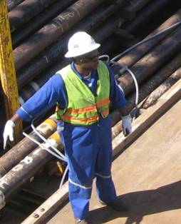
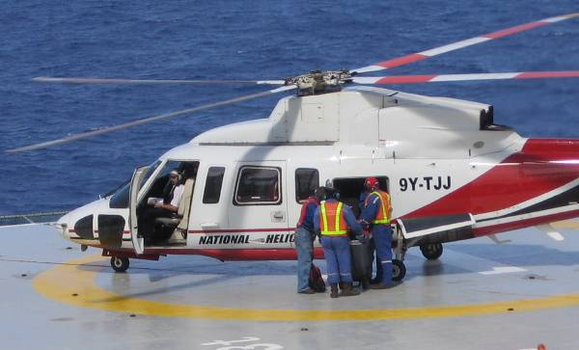
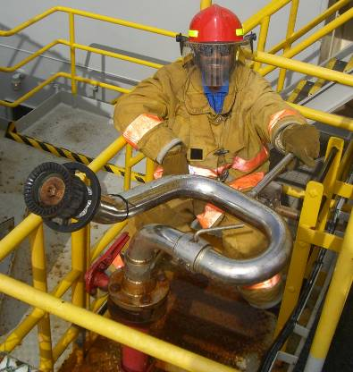
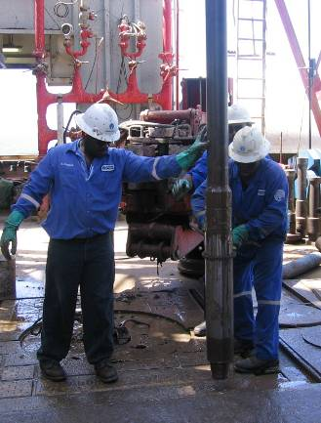
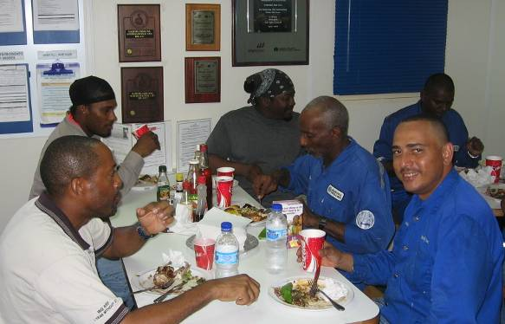
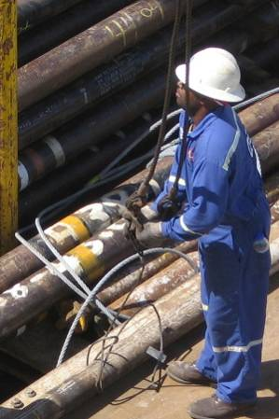
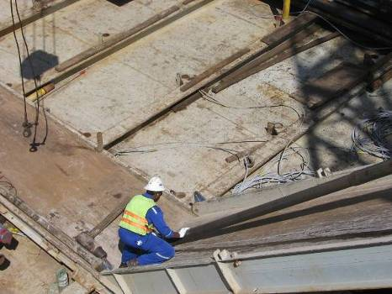
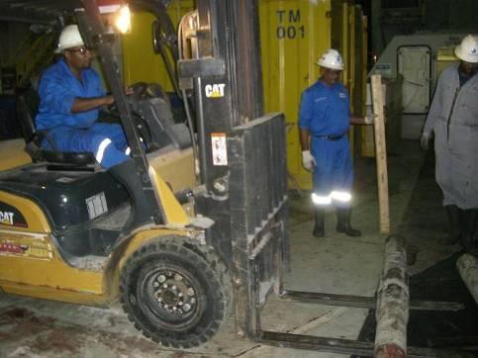
ROUSTABOUT OJT HANDBOOK
TYPICAL JOBS AND ACTIVITIES FOR THE ROUSTABOUT ON THE RIG
OFFLOADING CHOPPER
GIVING SIGNALS TO THE CRANE OPERATOR
ON DRILLFLOOR
FIRE FIGHTING DUTIES FOR HELICOPTER LANDINGS
EATING LUNCH WITH CO-WORKERS
WORKING ON CATWALK
WORKING WITH SLINGS
WORKING WITH FORKLIFT

Slide 8
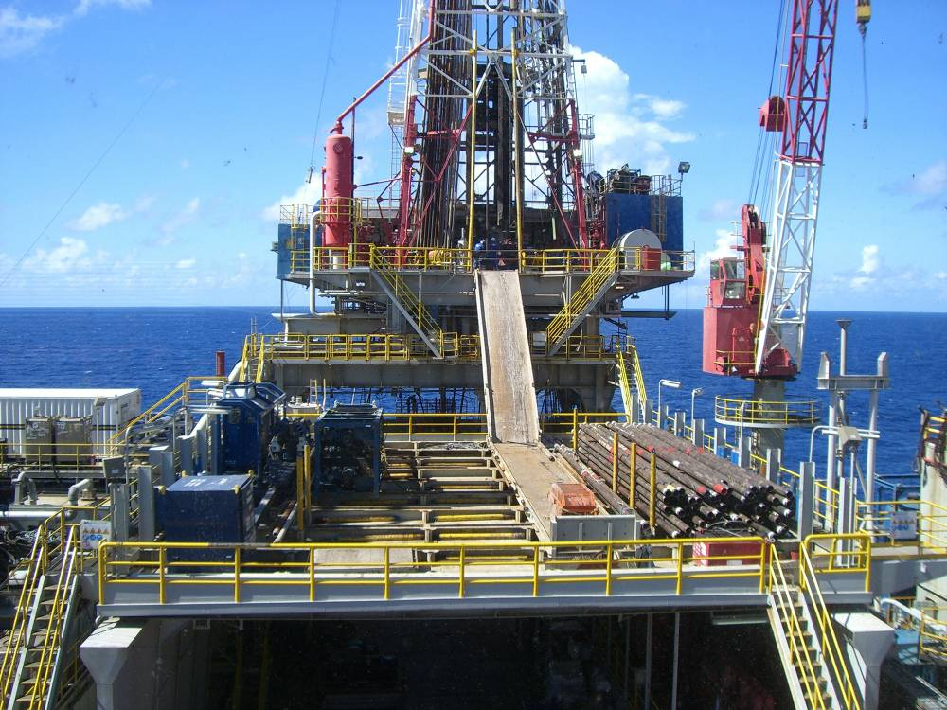
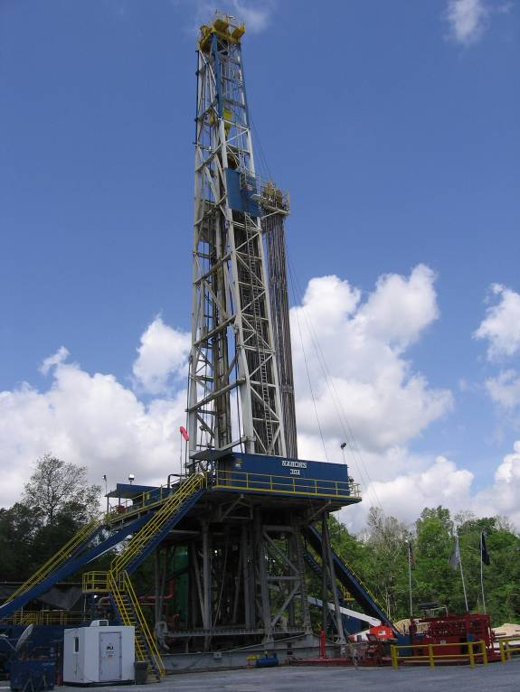
ROUSTABOUT OJT HANDBOOK
MODULE 1
Basic Drilling
Roustabouts may work on offshore rigs or on land rigs. There are differences between the two. Whichever rig you work on, you must become familiar with the safety procedures and policies of the rig.
OFFSHORE
LAND

Slide 9
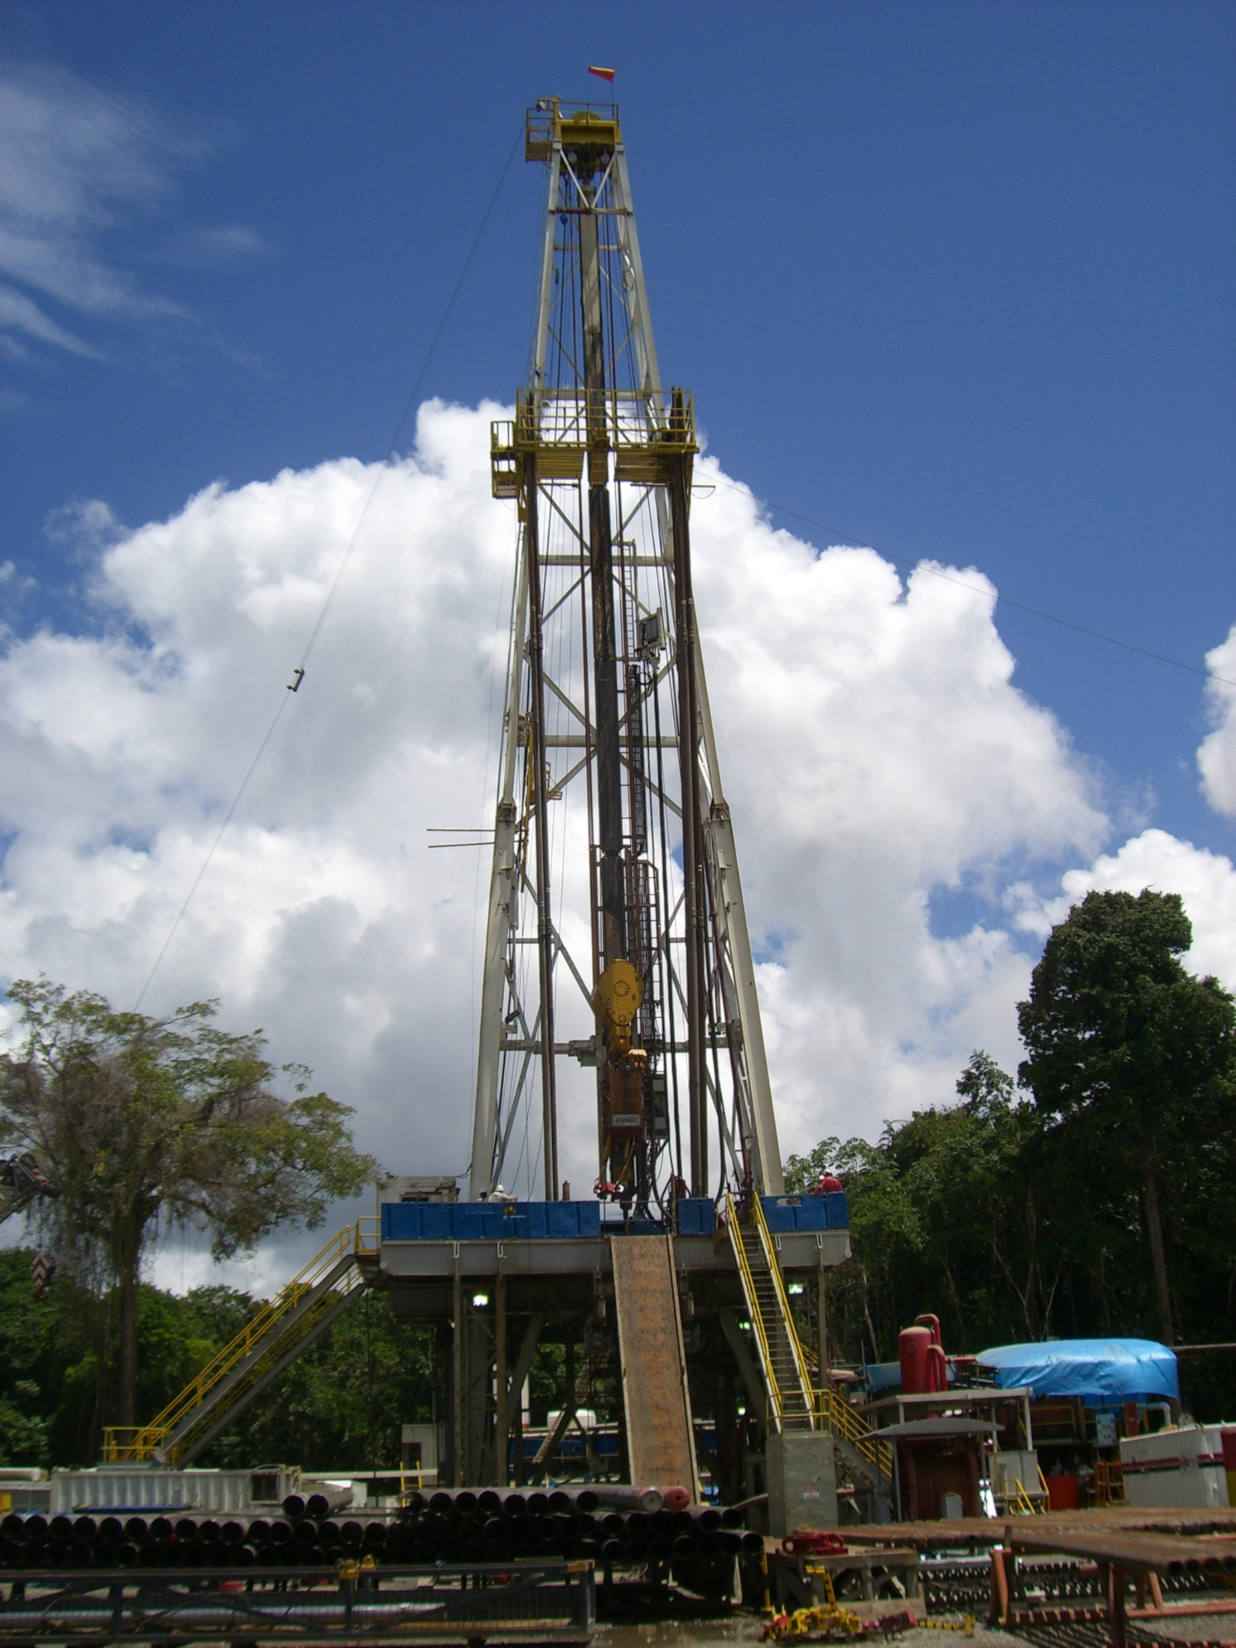
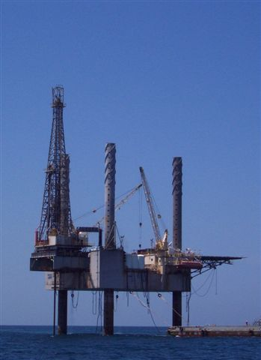
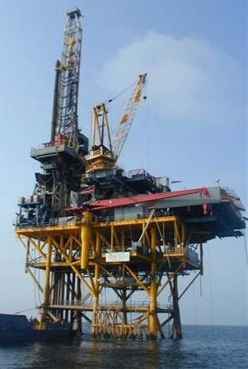
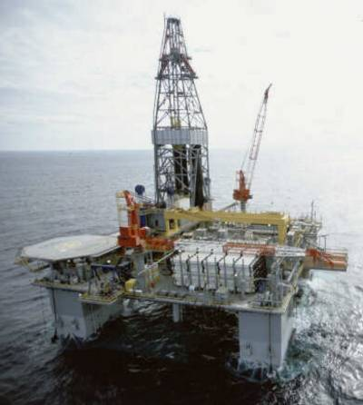
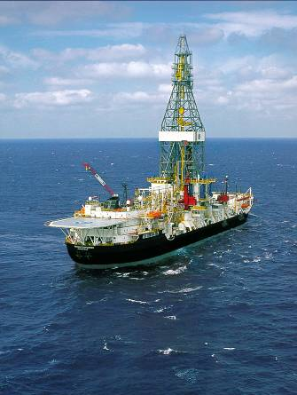
BASIC DRILLING
Offshore rigs are designed to meet specific operational requirements and therefore have different capabilities and characteristics. Offshore drilling rigs perform the task of drilling for oil and gas.
One type of drilling rig that drills offshore is a floating rig, which remains afloat while drilling and relies on anchoring or dynamic positioning systems to keep them over a drilling location. Drill ships or semi-submersible rigs are examples of floating rigs.
Other types of drilling rigs that are called stationary rigs are platforms and self-elevating rigs or jack-ups.
A jack-up rig can be floated to a location and raised up from the water with its long legs and its jacking system. Then, the drilling process starts and the objective is to drill a well to find oil and gas.
A platform rig is mounted on a drilling platform that is set on the ocean bottom. Several wells can be drilled from the platform.
A land rig is moved onto location with trucks and cranes. It takes a lot of loads to get it to a location. Each piece of the rig is then rigged up for the drilling process to begin.
LAND RIG
JACK-UP
Platform
OIL/GAS
SEMI-SUBMERSIBLE
DRILL SHIP
PLATFORM

Slide 10
BASIC DRILLING
PARTS OF A JACK- UP RIG
ACCOMODATIONS
CROWN
As Roustabouts gain experience, they will become familiar with all parts of the rig.
The Roustabout works all around the rig and has to work with all of the different supervisors.
The Roustabout is involved with the rig’s activities during the different phases of drilling a well.
This photo shows some basic parts of a jack up rig.
DERRICK
HELIDECK
DRILL FLOOR
CRANES
WELL
LIFE BOATS
JACK-UP LEGS
WORK BOAT

Slide 11
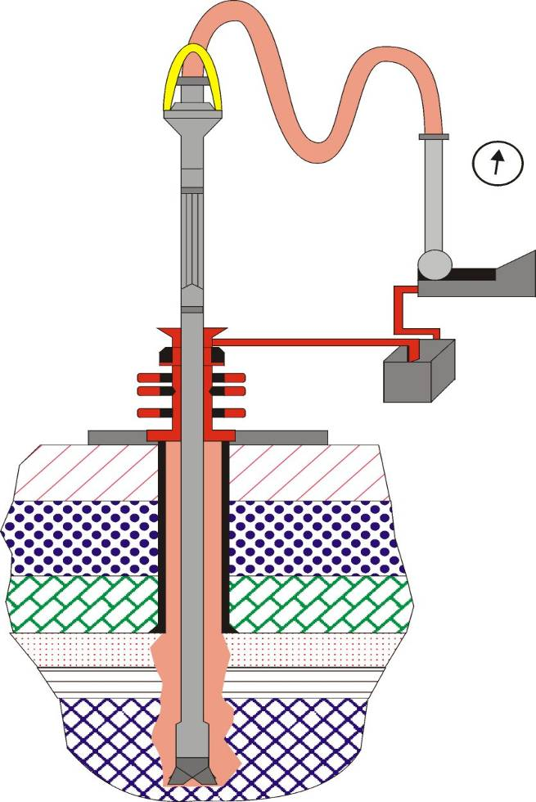
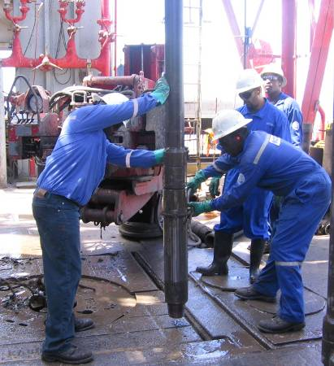


BASIC DRILLING
The main objective of the drilling rig is to drill an hole in the ground to find and produce oil or gas. The picture (left) shows the drilling process and the rig parts and circulation system to “make hole.” As the drillstring is rotated to the right and lowered by the Driller, the bit drills new hole. Part of the process is to circulate drilling mud from the mud pit through the rotary hose and swivel and down the drillstring, out the bit and back up the annulus, through the BOPs and across the flow line and back into the pits. The circulation process is repeated until the bit needs changing or the formation with oil/gas is penetrated.
Rotary Hose
Swivel
Standpipe or
Circulating Pressure
Flow Line
Standpipe
Kelly or Topdrive
Mud Pump
TRIPPING OUT
BOP
Mud Pits
Shakers
Rig Floor
STANDS
Casing
Formations
Annulus
Drillpipe
When the bit is worn out, the Driller and his crew will pull out of the hole (“trip-out”) to change the bit. When the bit is changed, then the crew returns the bit to bottom, called “tripping in.” The drillstring is made up of “stands” of drillpipe or three 30 to 31 foot joints of pipe that are screwed together to make a stand. Stands of drill collars and heavy weight drillpipe are run just behind the bit to provide weight on the bit. Then the drillpipe is run above the collars and heavy weight pipe. When the Driller and his crew adds a stand of pipe, this is called “making a connection.”
Drilling Mud
Wellbore
Drill Collars
12 ¼” Bit
Oil/Gas
12 ¼” DRILL BIT
USED TO DRILL HOLE

Slide 12



BASIC DRILLING
POWER SYSTEMS
Electrical Transmission (Diesel Electric Rig) - Diesel engines, electric generator, control cabinet, electric motor sends power to rig parts
SCR (Silicone Controlled Rectifier) - converts AC current from generator to DC current to drive large components
Power System provides energy for all of the rig equipment used on a rig for drilling the well.

Slide 13





Hoisting System
BASIC DRILLING
Derrick - Supports String & Block Weight
Draw works - Drum & Brake Lifts & Lowers Drill String
Crown Block - Stationary Pulley (Sheaves)
Traveling Block - Moving Pulley (Sheaves)
Drill Line- Wire Rope Reeved onto Blocks
Fast Line - Draw works to Crown Block
Dead Line - Crown Block to Tie Down Anchor to Storage Reel
Slip & Cut Line Maintenance is done after using the drill line for a calculated period of time.
CROWN
DRAW WORKS
BLOCK

Slide 14


Rotating System
BASIC DRILLING
TYPES OF ROTATING SYSTEMS USED ARE:
Swivel - Rotating connection at junction between Kelly Hose and Kelly
Conventional Rig - Swivel, upper Kelly cock, Kelly, lower Kelly cock, Kelly Bushings, Kelly Saver, and Rotary Table
ZENVORA uses a
Top Drive- Motor Powered Swivel, Drive Shaft. No Kelly Bushings/Rotary Table system.
CanRig Top Drive System
National Oilwell Top Drive

Slide 15







Circulating System
BASIC DRILLING
Mud Pits, Mud Pumps, Discharge Line, Standpipe, Rotary Hose, Swivel, Kelly or Top Drive, Drill Pipe, Drill Collars, Drill Bit, Annulus, Flow Line, Shale Shakers, Desander, Desilter, Mud Pits
Closed Loop System - Suction = Discharge No Gains & No Loses
Drilling Fluids (Mud) - WBM, OBM, SBM
Mud Tanks - Surface Volume Storage
Mud Pumps - 2 or 3 Low Pressure/High Volume Pumps moves fluid through system
Surface Lines - Pump to Kelly/Top Drive
Drill Stem - Surface to Bit
Annulus - Bit to Surface
Return Line - Flow Line to Mud Pits
Shale Shakers - Removes Large Cuttings from Mud.
Desanders/Desilters - Removes Small Solids from Mud
Degassers - Poor Boy/Vacuum Types
Bulk System - Air Driven Storage Tanks for Barite, Bentonite, Cement
Mud Valves
Shakers
Degasser
Mud Hoppers for Mixing
Mud Pumps
Pulsation Dampner on Pump
Bulk Container for Barite

Slide 16





Drill Bits
BASIC DRILLING
The different types of bits are:
Roller Cone Bits
  Insert
  Milled Tooth
Fixed Head Bits
  PDC
  Diamond
Bit Sizes
  - 26” to 6”
Breaking out the bit
Bits are chosen by the type of formation to be drilled. Roller cones are used for soft formations, Fixed heads are used for harder and diamond bits are used for hard, abrasive formations.

Slide 17










BASIC DRILLING
When a new Roustabout gets on the rig they need to meet the people in key leadership roles and learn the different positions.
  The Company Man works for the oil company that hires the rig to drill the well.
  The Rig Manager is the leader for the rig crews on the rig and coordinates the work requested by the Company Man. He supervises the Toolpusher.
  The Driller is the leader on the drill floor for the Asst. Driller, Floorhands and Derrickmen and reports to the Toolpusher.
  The Lead Roustabout or Deck Foreman is the leader for the Roustabouts and reports to the Toolpusher
  The Roustabout reports to the Lead Roustabout/Deck Foreman.
  Other supervisors that report to the Rig Manager/Toolpusher on-board the rig are Mechanics and Electricians.
  Third-party service personnel, such as Cementers, Wire line Operators, Mud Engineers, Mud Loggers, etc., are hired by the oil companies to provide services on-board, and report to the Company Man.
Rig Manager\ Co. Man
Welder
Roustabout
Roustabout
Barge Engineer\ Electrician
Driller
Mechanic/Motorman
Derrickman
Floorhand
Crane Operator

Slide 18




ROUSTABOUT OJT HANDBOOK
MODULE 2
EMERGENCY SITUATIONS

Slide 19





EMERGENCY SITUATIONS
All drilling rigs are subject to emergency situations and all of the rigs have an emergency system to handle these conditions. All ZENVORA rigs have an emergency signaling system. Station Bills are posted throughout the living quarters, which provide specific instructions on where each person is to go and what they are to do in the event of a fire, man overboard or abandonment. Everyone is to know the Station Bill and the duties in case of emergency.
Immediately report an emergency situation to the Supervisor, i.e., fire, gas, oil spill, man overboard, etc. (An unplanned discharge could be drilling fluid, diesel, gasoline, or oil and needs to be reported as quickly as possible.)
Emergency signals are sounded by ringing of the general alarm bells on the rig. Everyone will be briefed on the signals for their particular rig during the orientation on the rig and in weekly safety meetings. Also, different types of drills will be held to let everyone onboard get familiar with the emergencies that can occur. Types of signals would include boat stations, fire and gas, man overboard, and all clear. All personnel are to participate in the drills and become familiar with the different signals, alarms, and procedures for emergencies for the rig they are working on.
EMERGENCY LIGHTING
FIRE ALARM
GENERAL ALARM
RIG STATION BILL GIVE SPECIFIC INSTRUCTIONS ON HOW TO REACT TO EMERGENCY SITUATIONS..
EMERGENCY SIGN
ESCAPE ROUTE
All persons must know the alarm signals, their emergency stations and their duties at the station.

Slide 20







EMERGENCY SITUATIONS
Everyone on the rig will be assigned to a lifeboat station in case of an extreme emergency. Lifeboats are a highly effective means of evacuating personnel from the rigs.
These boats are made for safe evacuation because they are designed to be enclosed, provide life support, are fire resistant, are unsinkable, are highly detectable and can carry large groups of people. These boats contain the necessary life-saving equipment, flares, water, first-aid kit, and other supplies to help the crew survive an evacuation.
LIFE PRESERVER
LIFEBOAT
FLARES ARE IN THE LIFEBOAT FOR EMERGENCY USE.
LIFE RING
If a person falls overboard, immediate action is needed. Verbal communication . . . “Man Overboard” is passed on to everyone on the rig. A life ring can be thrown to the person or a man overboard gun can be used to help in the rescue. The standby vessel can be alerted and a rescue boat can be launched.
BLOWOUTS, FIRES, MAN OVERBOARD, HYDROGEN SULFIDE GAS, AND ABANDON RIG ARE EMERGENCY SITUATIONS.
LIFE BOAT MUSTER STATION NO. 4

Slide 21

EMERGENCY SITUATIONS
LIFE PRESERVERS
Life preservers, sometimes referred to as personal floatation devices (PFD), are located in each bedroom and in life preserver storage containers at designated locations as indicated on the Fire Control or General Emergency Equipment Plan.
Life preservers are to be properly donned for any emergency drills and during actual emergencies.
Personnel life preservers are located in various access points on the rig and shall be easily accessible at all times.
All life preservers shall be inspected for any defects and removed from service and replaced when defects are found.
ZENVORA provides only U.S. Coast Guard approved life preservers.
PROPERLY STORED GALLEY
INDIVIDUAL LIFE PRESERVERS

Slide 22


EMERGENCY SITUATIONS
EMERGENCY DRILLS
Everyone on the rig will be assigned to a lifeboat station in case of an extreme emergency. Lifeboats are a highly effective means of evacuating personnel from the rigs.
All personnel on board will participate in fire and abandon drills each week to ensure their safety and to understand their role in any emergency.
These boats are made for safe evacuation because they are designed to be enclosed, provide life support, are fire resistant, are unsinkable, are highly detectable, and can carry large groups of people. These boats contain the necessary life-saving equipment, flares, water, first-aid kit, and other supplies to help the crew survive an evacuation.
Drills are held each week to train personnel, to check their response to an emergency, and to account for all personnel onboard the rig. Alarms for fires, fire drills, abandon rig, man overboard, and a gas release will be explained to everyone working on the rig.
OVERBOARD DUMMY
MAN OVERBOARD DRILLS ARE PERFORMED ON A REGULAR BASIS TO ENSURE THE CREWS ARE TRAINED IN MAN OVERBOARD PROCEDURES.

Slide 23

EMERGENCY SITUATIONS
MAN OVERBOARD
If a person falls overboard, immediate action is imperative to increase the chance of survival for the person overboard.
Verbally yell “Man Overboard” or when possible use the Rig’s intercom system to make the announcement “Man Overboard” to warn all other personnel aboard the Rig.
Various types of rescue are available as follows:
1. Always maintain visual contact with the person in the water and whenever possible throw a “Life Ring” near the person in the water.
2. If necessary use the emergency “Line Throwing Device” also called “Man Overboard “ life line buoy to get a line as close to the person as possible so they can hold onto the line.
3. Notify the Rig’s standby boat and get the Captain to immediately move to the area where the person overboard is or was last seen.
4. If a standby boat is not available, take the necessary steps to launch one of the emergency escape craft on the Rig.
STORED LINE THROWING DEVICE STORAGE
STAND-BY BOAT

Slide 24

EMERGENCY SITUATIONS
Everyone on the rig will be assigned to a life boat station for use in an extreme emergency. Lifeboats are a highly effective means of evacuating personnel from the rigs.
All personnel on board will participate in fire and abandon drills each week to ensure their safety and to demonstrate their role in any emergency.
These boats are made for safe evacuation because they are designed to provide life support, are fire resistant, are unsinkable, are highly detectable, and can carry large groups of people. These boats contain the necessary life-saving equipment, flares, water, first-aid kit, and other supplies to help the crew survive an evacuation.
RIG EMERGENCY INSTRUCTIONS ARE GIVEN TO EVERYONE ON THE RIG.

Slide 25




EMERGENCY SITUATIONS
FIRE FIGHTING
Each rig will have a emergency firefighting and life saving equipment plan that shows the location of equipment and includes the roles and responsibilities for everyone on the rig. Fire fighting equipment shown here includes fireman bunker gear, SCBA (Self Contained Breathing Apparatus), fire hoses and fire extinguishers that are used to fight the fires. Fire drills will be held on the rig to familiarize everyone with the procedures and equipment for combating fires. Remember to report any fire that is seen and sound the alarm and always know where the emergency equipment is located. Also, any accidental discharge or the use of fire fighting equipment must be reported to the Supervisor.
SCBA
HELMET & SHIELD
SCBA
GLOVES AND FLASHLIGHT
GLOVES AND FLASHLIGHT
BOOTS
BUNKER SUIT
FIRE FIGHTING SUIT, BOOTS, FLASHLIGHT, GLOVES, HELMET, SHIELD, AND THE REQUIRED SELF-CONTAINED BREATHING APPARATUS (SCBA) LAYED OUT FOR INSTRUCTIONAL PURPOSES AND VISUAL INSPECTION AND THEN STORED IN ONE OF THE RIG’S WATERTIGHT CONTAINERS.
PROPERLY DONNED FIRE FIGHTING SUIT SHOWING PROPER LEAD NOZZLE POSITION WHILE TESTING THE NOZZLE PATTERN

Slide 26






EMERGENCY SITUATIONS
The Roustabout will be part of the fire-fighting team on the rig. Each rig will have a emergency firefighting and life saving equipment plan that shows the location of equipment and includes the roles and responsibilities for everyone on the rig. Fire fighting equipment shown here includes fireman bunker gear, SCBA (Self Contained Breathing Apparatus), fire hoses and fire extinguishers that are used to fight the fires. Fire drills will be held on the rig to familiarize everyone with the procedures and equipment for combating fires. Remember to report any fire that is seen and sound the alarm and always know where the emergency equipment is located. Also, any accidental discharge or the use of fire fighting equipment must be reported to the Supervisor. The Roustabout will be trained in how to locate and use the emergency equipment on board the rig.
FIRE CONTROL PLAN
FIREMAN BUNKER GEAR
FIRE EXTINGUISHERS
SCBA
FIREMAN BUNKER GEAR
STORED FIREMAN GEAR
ACCESS TO SAFETY EQUIPMENT WILL NOT BE RESTRICTED IN ANY WAY.

Slide 27


Fire Alarms
EMERGENCY SITUATIONS
If alarm is sounded go to designated muster point
Do not ignore alarms. Treat them all serious
Sound alarm if you discover a fire
If you are trained, its safe, & you feel confident in your abilities extinguish the fire with appropriate equipment
Consider your and co-workers safety first!
Pay special attention when working hazardous areas
Notes:
.

Slide 28
The Fire Triangle
EMERGENCY SITUATIONS
HEAT to reach ignition temperature
Oxygen
Heat
OXYGEN to sustain combustion
FUEL or combustible material
Fuel
Fire Safety, at its most basic, is based upon the
principle of keeping fuel sources and ignition sources separate.

Slide 29




Fires Classifications
Fires are classified according to the type of fuel that is burning. If you use the wrong type of fire extinguisher on the wrong class of fire, you might make matters worse, or even hurt yourself.Its very important to understand the four different fire (fuel) classifications…
EMERGENCY SITUATIONS
Class A: Wood, paper, cloth, trash, plastics—solids that are not metals.
Class B: Flammable liquids—gasoline, oil, grease, acetone. Includes flammable gases.
Class C: Electrical—energized electrical equipment. As long as it’s “plugged in.”
Class D: Metals—potassium, sodium, aluminum, magnesium. Requires Metal-X, foam, and other special extinguishing agents.

Slide 30

EMERGENCY SITUATIONS
FIRE FIGHTING EQUIPMENT
Fire extinguishers of a class suitable for the most likely type fire in a given area are located throughout the Rig and Offshore Service Vessel(OSV) at each designated station.
The fire extinguishers are located on the Fire Control Plans posted throughout the Rig or OSV. Most fire extinguishers will have a pictograph label telling you which types of fire the extinguisher is designed to fight.
Different types of fire extinguishers are designed to fight different classes of fire. The 4 most common types of fire extinguishers are:
Carbon Dioxide (CO₂)
Dry Chemical
Water
Foam
The Driller and his crew must know which agent to use in case of fire.
CO₂ FIRE EXTINGUISHER

Slide 31



EMERGENCY SITUATIONS
Portable Extinguishers
Water
CO₂
Foam
Powder

Slide 32
EMERGENCY SITUATIONS
INSPECT ALL FIRE EXTINGUISHERS FOR MISSING PARTS OR DAMAGE.
Fire extinguishers are to be used on small fires to prevent their getting out of control.
It is necessary that extinguishers are at top efficiency the instant they are needed.
A competent person will be assigned the responsibility for proper inspection and maintenance of all fire fighting equipment.
A tag bearing the date of inspection should be attached to each fire extinguisher. They shall be inspected every hitch and monthly.
Fire extinguishers, when used, should be sent in to be refilled.
Report all used fire extinguishers and damaged or missing equipment to the relevant supervisor immediately,
BRACKET STRAP AND CARRYING HANDLE.
CHECK PRESSURE GAUGES
CHECK HOSES AND NOZZLES

Slide 33

EMERGENCY SITUATIONS
WATER
Extinguishes the fire by cooling.
Used on class ‘A’ type fires such as burning wood, paper, coals,
Water is usually supplied via hoses, not extinguishers on most drilling rigs.
Do not use water on electrical fires or fires involving flammable liquids.

Slide 34

EMERGENCY SITUATIONS
FIRE HOSE STATIONS
Fire stations consisting of a hydrant, fire hose, fire nozzle, and spanner wrench are located throughout the Rig or Offshore Service Vessel (OSV).
Using water to fight fires:
Use hose and nozzle properly
Approach with solid stream of water for best reach
Aim high into the hottest area of fire
Sweep the hose back and fort to create a fog effect
Be careful of steam generation from enclosed fires
Can create back draughts blowing smoke back
Never turn your back on the fire. Walk backwards away from the fire.
UNOBSTRUCTED, PROPERLY LABELLED FIRE HOSE STATION

Slide 35
EMERGENCY SITUATIONS
FOAM
Extinguishes the fire by smothering surface
Good for liquid fires
Only trained personnel should use
Reduces temperature; reducing toxic vapors
Do not use on Electrical Fires

Slide 36

EMERGENCY SITUATIONS
DRY POWDER
Breaks chemical chain reaction
Used on Class A & B fires
Not used on Class C
No cooling effect
Risk of reignition
Ensure safe line of retreat
Could be used on all classes of fires, depending on conditions

Slide 37

EMERGENCY SITUATIONS
CO2
Remove oxygen from the fire triangle
Very effective in confined spaces
Electrical fires
Considered an asphyxiant; be careful!
Could be used on all classes of fires, depending on conditions

Slide 38



EMERGENCY SITUATIONS
HOW TO USE A FIRE EXTINGUISHER
It's easy to remember how to use a fire extinguisher if you can remember the acronym PASS, which stands for Pull, Aim, Squeeze, and Sweep.
Pull the pin.
This will allow you to discharge the extinguisher.
Aim at the base of the fire.
If you aim at the flames (which is frequently the temptation), the extinguishing agent will fly right through and do no good. You want to hit the fuel.

Slide 39


EMERGENCY SITUATIONS
Squeeze the top handle or lever.
This depresses a button that releases the pressurized extinguishing agent in the extinguisher.
Sweep from side to side
until the fire is completely out. Start using the extinguisher from a safe distance away, then move forward. Once the fire is out, keep an eye on the area in case it reignites.

Slide 40

EMERGENCY SITUATIONS
EMERGENCY EXITS
Each level of the Rig’s Living Quarters has at least two Emergency Exits.
These Exits must remain unobstructed at all times. Any violations shall be reported to your immediate Supervisor or his designated representative at once.
Nothing is to be placed immediately inside or outside and Emergency Exit.
TYPICAL LIVING QUARTERS EMERGENCY EXIT

Slide 41


EMERGENCY SITUATIONS
EMERGENCY AIR PACKS
Self-contained breathing apparatus (SCBA), or 30 minute air packs, are provided in the event it becomes necessary to enter an area that is oxygen deficient, an area where the atmosphere may be contaminated with dust, gases, or vapors that could pose a hazard to life, or when working on a Rig where hydrogen sulfide (H2S) is known to be present, particularly when another person has fallen unconscious and a means of safe rescue is required.
Every space occupied by Rig personnel will be provided with a personal SCBA whenever the Rig is working in an H2S environment. H2S characteristics: colorless, smells like rotten eggs, affects breathing, flammable, heavier than air. H2S is known as the “silent killer.”
You will be properly trained in the use of the SCBA, and it is your responsibility to know how to use this lifesaving equipment.
EMERGENCY AIR PACKS

Slide 42



ROUSTABOUT OJT HANDBOOK
MODULE 3
SAFETY MANAGEMENT SYSTEM
ZENVORA Safety Management System is critical to the success of the company.

Slide 43

ZENVORA PRINCIPLES
SAFETY MANAGEMENT SYSTEM
Safety is equal to all other aspects of our operations: Production, Cost and Quality
All injuries can be prevented
Safety is Everyone’s Responsibility
All Hazards can be Reasonably Safeguarded
Line Management Has a Responsibility to Train all Employees to work Safely
Safety is a condition of Employment
Preventing Injuries is Good Business
Company man, third party, and ZENVORA leadership talking about the safe way to run a liner.

Slide 44


SAFETY MANAGEMENT SYSTEM
THE SMART CYCLE
WHAT IS SMART ?
  SMART is an
    Observation
    Communication and
    Reporting program
SEE
Write
SIGN
SAY/Stop
Unsafe Act
    S Safety
    M Makes
    A
    R Real
    T Team

Slide 45





SAFETY MANAGEMENT SYSTEM
As part of the Behavior Based Safety System, the SMART Program will be used on the rig. All personnel will be trained in how to use this system. Safety observations are for the purpose of preventing a serious incident or accident from occurring. As part of the corrective action process, SMART cards and feedback are used to identify and document safe and at-risk behaviors, as well as equipment and conditions. The steps for doing this process include:
  Observing a person work, having a conversation about their work, and getting a commitment from the person to work more safely. Encouragement is also given to personnel that are working safely.
  The Observer will then record the discussion and commitment on the STOP card and give it to the Safety Facilitator. An example of a SMART card is pictured here. The front of the SMART card is shown on the left and the back of the SMART card is shown on the right.
OBSERVING
CONVERSATION
GETTING COMMITTMENT

Slide 46





SAFETY MANAGEMENT SYSTEM
Before doing a critical task on the rig, there will be a safety meeting to discuss the task with all persons involved in the task. To work successfully and safely each task needs to have teamwork to accomplish the job properly. Just like a football team needs to meet and discuss plays and strategy for an up-coming game, the rig team does the same thing for an up-coming job task.
The JSA (Job Safety Analysis), work permit, risks and hazards of the job will be discussed so everyone will know their role and responsibilities for doing the job safely and efficiently.
This provides an excellent time for the new Roustabouts to learn and ask questions about the job and to try and understand the procedures to be done.
Everyone is expected to pay attention and to ask questions to help clarify the key points. There are no “stupid” questions! Everyone is encouraged to ask questions when they do not understand!
These photos show the supervisors going over the list of suggestions and comments about a specific job task that is going to be carried out on the rig by the Roustabouts.
REVIEWING JSA WITH SUPERVISOR
REVIEWING POLICIES
ASKING QUESTIONS AND DISCUSSING ARE A MUST FOR SUPPORT OF THE JSA AND FOR THE UNDERSTANDING OF THE TASK BY ALL PARTICIPANTS!
TEAMWORK
PREPARING THE JSA

Slide 47

ZENVORA GROUP

Slide 48

WHY JSA’s ARE PERFORMED
SAFETY MANAGEMENT SYSTEM
To discover the safety hazards involved with a particular task
Ensure that all crew members are aware of hazards
Define and prioritize the proper sequence of task
Reinforcement of appropriate RMS procedures
Involvement of crew members in defining task execution
Reduce and / or eliminate the hazard
Communication..Communication..Communication
“THE JSA IS THE BACKBONE OF OUR SAFETY PROGRAM.”

Slide 49

SAFETY MANAGEMENT SYSTEM
WHEN SHOULD WE DO A JSA?
Jobs which have produced any disabling injury or fatality
Jobs with the highest frequency of incidents
Jobs with potential for serious injuries
New jobs, changed jobs, new rules, regulations, standards
If you have to ask yourself, “Do I need a JSA?”
BENEFITS:
Reduces injuries
Reduces absenteeism
Increases productivity
Increases morale
Protects employees
Assists in standard-specific compliance (e.g., personal protective equipment)
What is the purpose of our JSA?
Uncover hazards associated with each task.
Make recommendations to eliminate, control and manage risk.
List the job steps.
JSAs HELP PREVENT INCIDENTS!

Slide 50
STEPS IN PERFORMING A JSA
SAFETY MANAGEMENT SYSTEM
Break down the steps in the job
Identify hazards for each step
Evaluate the hazard
Recommended safe procedures and protection measures
Evaluate, Equipment, Procedures, and Personnel
Revise the JSA
JSA to be conducted by person(s) doing the job.
All employees involved in the job will be present when the JSA is conducted.
New employees need to be fully involved in the JSA process.

Slide 51

SAFETY MANAGEMENT SYSTEM
Developing a J.S.A.
 STEP ONE:
Select the job to be analyzed
 STEP TWO:
Break the job down into the steps/activities to be done
 STEP THREE:
Identify the hazards associated with each step and protective tools/equipment needed.
 STEP FOUR:
Develop safe procedures to eliminate potential accidents
Notes:
BREAK
Followed by Teamwork & Performance Management slides.

Slide 52

IDENTIFYING
HAZARDS
SAFETY MANAGEMENT SYSTEM
EVALUATING
HAZARDS
Sharp edges
Employee jewelry
Potential for being caught between
Worker posture/balance
Hazardous movements
“Struck by” hazards
Suspended loads
Environmental hazards
What PPE is available?
Has worker been trained?
Is the worker positioned properly?
Is lockout/tagout used?
Does the job need a Work Permit?
What is the flow of work?
What are the sources of chemicals, noise, etc.
Are slips, trips, and falls a possibility?

Slide 53
Sample JSA - Body
SAFETY MANAGEMENT SYSTEM

Slide 54

Hazard management is essential for …
SAFETY MANAGEMENT SYSTEM
LIST THE JOB STEPS
(THE FIRST COLUMN OF THE JSA FORM)
FIRST!
In Sequence…
Do not attempt to identify hazards until ALL STEPS are listed, if you do you could skip an important step!
“WHY LIST THE JOB STEPS? WE DO THIS ALL THE TIME!”
Job clarification!
Triggering hazard awareness
INFORMING EMPLOYEES
Re-training SENIOR employees
Refresher for jobs infrequently done

Slide 55

SAFETY MANAGEMENT SYSTEM
97% ________________
At-risk Behaviors
Using A Job Safety Analysis
  Often we use a JSA that has already been written.
  Ask some questions about THIS job and the JSA.
    Are the conditions changed or the same?
    Does this crew have experience on this task?
    What unsafe acts need to be monitored?
    Are there any equipment related problems?
    Have additional risks been identified?

Slide 56


LIST POTENTIAL INCIDENTS/HAZARDS
(THE SECOND COLUMN OF THE JSA FORM)
SAFETY MANAGEMENT SYSTEM
Be specific . . . !
What could happen if . . .?
Shortcuts employee might be tempted with
Pinch point is . . . !
Trap is . . . !
Motion is . . . !
If we don’t do what we say we are going to do . . . !
Recommended Safe Job Procedure (Controlling the Hazard)
Safeguards
PPE
Explore any and all recommendations to minimize hazards
Elimination
Isolation
Substitution
Responsibilities/accountabilities

Slide 57

SIX STEPS TO HAZARD MANAGEMENT
SAFETY MANAGEMENT SYSTEM
Eliminate
Substitute
Isolate
Controls to Minimize
Provide PPE
Accept and manage risk through the above process!
Accountability/Responsibility
Assign specific duties to specific people to make sure things happen as they are supposed to happen!

Slide 58



RECOMMENDATIONS TO ELIMINATE OR
REDUCE POTENTIAL HAZARDS
(THE THIRD COLUMN OF THE JSA FORM)
SAFETY MANAGEMENT SYSTEM
Physical safeguards: Walls, electrical isolation, closed valves, well maintained equipment, right tools for the job . .
Human actions as safeguards: Monitoring critical parameters, manually controlling process, skilled observation . . .
Administrative controls as safeguards: Lock out / Tag out Procedure, Hot Work Permit, Confined Space Entry . . .

Slide 59



SAFETY MANAGEMENT SYSTEM
The Work permit system is established to provide a barrier to ensure all hazards associated with specific operations are assessed, known and communicated prior to being executed
A Signed statement by an authorized person that a non-routine job may be carried out under controlled conditions
  Applies to all non-routine work activities such as:
  - General Cold Work - Excavation
  - Hot Work - Radioactive
  - Man Rider Operations - Diesel Transfer
  - Live Circuit Access - Working Over Water
  Confined Space Entry - Diving

Slide 60

TYPICAL NON-PERMIT JOBS
Does not involve hot work, little or no risk, will not conflict with other work, is not complex, have adequate controls in place
SAFETY MANAGEMENT SYSTEM
Tripping pipe
Making connections
Crane & forklift use, operated by competently trained personnel
Lowering mast
Loading boats or trucks
Inspecting equipment
Mixing mud chemicals
Cleaning non energized equipment
Housekeeping

Slide 61


TYPICAL PERMIT JOBS
SAFETY MANAGEMENT SYSTEM
Any Hot Work offshore, or within 150’ of well bore on a land rig
Working in a confined space
Mud Pump maintenance
Working at heights
Live circuit access
Working on equipment which requires energy isolation
Hoisting personnel with the Man Riding winch
Handling of radioactive material
Handling of explosives
Acid handling
All work on steam lines
Sand blasting during any operation
Scaffold erection
All Pressure Testing of equipment on the rig
Excavation work (on land)
Diesel Transfer (offshore)

Slide 62

SAFETY MANAGEMENT SYSTEM
FORMS USED BY THE CREWS TO MAINTAIN SAFETY STANDARDS WILL BE EXPLAINED TO ALL CREW MEMBERS.
Notes:
Show an example of the JSA form

Slide 63



SAFETY MANAGEMENT SYSTEM
TAGS AND LOCKS
ELECTRICAL LOCKOUT
The Lockout/Tagout Program is part of our Safety Management System. Before doing maintenance on rig equipment, such as a mud pump, crane, electric motor, engine, or generator, the equipment must be rendered inoperative by “locking out” and “tagging” the equipment with the proper tag (as shown in the photos). This ensures that the equipment being worked on is not accidentally operated. The tags must not be removed without the permission of either the person who placed the tags, that person’s immediate supervisor, or their respective relief. Electrical, mechanical, pneumatic and hydraulic equipment would require energy isolation.
The OIM authorizes a work permit and isolation procedures for doing repairs and maintenance on equipment. Locks and tags should only be removed after service or maintenance has been performed and personnel and equipment are cleared from the work area. Any questions about when and how to use these procedures should be directed to the Supervisor.

Slide 64
SAFETY MANAGEMENT SYSTEM
Referred to as LOTO
Blocks flow of energy from power source to the equipment
Provides means of warning (tag & Lock), when servicing or maintaining equipment
Used when hazardous energy exists, when unexpected start-up could occur, or
Used when employees are required to place any part
of their body in harm’s or are required to remove or bypass a safety device

Slide 65





TYPES OF LOTO DEVICES
SAFETY MANAGEMENT SYSTEM
HASPs
Locks
Tags
Cables
HASPs w/ Tags

Slide 66

COMMON LOTO APPLICATION
SAFETY MANAGEMENT SYSTEM
Presses
Saws
Engines
Pumps
Generators
Mechanical Drives
Electrical

Slide 67

SAFETY MANAGEMENT SYSTEM
Reporting Unsafe/Hazardous Conditions and Accidents
Report any unsafe condition or hazard to the OIM/Rig Manager immediately - your proactive approach can prevent an accident or injury to you or your fellow employee.
What Makes An Accident A Recordable?
Administration of prescription medication
Sutures
Removal of a foreign body embedded in eye
Admission to a hospital for treatment
Physical Therapy or Chiropractic treatment
IV fluids for work related stress
Certain work restrictions that affect regular job duties

Slide 68





ROUSTABOUT OJT HANDBOOK
MODULE 4
HEALTH, SAFETY AND ENVIRONMENT
ZENVORA is committed to preserving the environment and taking care of the health and welfare of it’s people.

Slide 69



HSE – Alcohol/Drugs/Firearms
It is the policy of this company to prohibit the use, sale, transfer or possession of illegal drugs, drug related paraphernalia, regulated drugs not prescribed to the individual, alcoholic beverages, firearms, pyrotechnics, dangerous weapons and/or other contraband on company premises or work sites.
Testing - Pre-employment, random, post-accident, reasonable cause and operator requested
ZENVORA will perform these tests to assist in maintaining a drug free work place
All prescription medication must be reported upon arrival at the rig
Prescription must be in the original container and have only that prescribed medication inside
Must be within prescription’s date
Must be accompanied by a note from the physician stating that these drugs can be taken while working around industrial equipment
It is a violation of ZENVORA policy to give your prescriptions to other fellow employees !
ZENVORA reserves the right to search any and all belongings of persons departing for, leaving from, or present on company property or work locations.

Slide 70


HSE – First Aid
  First-aid kits and supplies are located around rigs.
  Trained personnel in basic first aid.
  All rigs maintain adequate first aid supplies.
  Supervisory personnel are adequately trained to respond to first aid situations.
  Safety reps on the rig.
  In the event of injury, get help & report incident to the Toolpusher
  Report all injuries regardless of how insignificant you may think they are
  Respond only to the extent you are trained. Call for qualified assistance.
Bloodborne Pathogens
Definition - Bloodborne Pathogens are pathogenic micro-organisms that are present in human blood and can cause disease in humans.
These pathogens include, but are not limited to, hepatitis B Virus (HBV) & Human Immunodeficiency Virus (HIV)

Slide 71



HSE – Fire Prevention
Smoking and non-smoking areas should be designated to the drilling unit. Signs printed in English and the predominant local language should be present in these areas.
Welding or burning is not permitted on the drilling location without prior hot work permits. Welding operations should be ceased in the event of hazardous conditions developing.
  During refueling operations or the transfer of fuel on the rig unit, all piping and connections should be checked to ensure against leakage that could lead to ignition. Fuel trucks are to be grounded while transferring fuel.
  Care should be taken not to overfill tanks during refueling as fuel can overflow through the vents, pouring all over the location.
  Do not overload electrical circuits.
Alarms and Lights for Gas and Fire

Slide 72




HSE – Fire Prevention
FIRE WATCHING
Whenever any cutting or welding is to take place outside of the designated welding area, a “Hot Work Permit” is to be issued by the OIM. A Roustabout may be assigned to fire watch and will be available to assist the Welder when needed with the proper fire fighting equipment.
The Roustabout has to make sure the proper PPE is worn when working around the Welder. The Welder’s equipment can cause severe damage to eyes if the proper glasses are not worn. As shown, the Roustabout is standing in a safe position while the Welder works.
As the Welder uses his cutter to cut some pipe, a Fire Watchman stands by on fire watch, alert and ready to help.
Proper fire watch entails being trained to use a fire extinguisher, have the proper protection equipment in place, and knowing where the nearest fire call point is located.
The Fire Watchman helps the Welder set up and rig down equipment for the job. This may involve setting up safety barriers around the job so no one gets injured by the intense heat and bright flashes that the Welder’s torch can generate. The Fire Watchman also has to help make sure the area is ventilated properly as fumes and gases can accumulate in confined areas.
FIRE WATCHMAN WITH THE PROPER FIRE FIGHTING EQUIPMENT

Slide 73






HSE – Personal Protective Equipment
WORK VEST
Everyone will in general be advised of the personal protective equipment required for a given task; however, if there is any question, the employee shall take the initiative to check with the Supervisor. Anyone not wearing the proper PPE is to be reported immediately. All equipment is to be inspected prior to use and any worn or defective part is to be reported to the Supervisor.
SAFETY HARNESS
PPE FOR WORKING AT HEIGHTS
EAR MUFFS
DISPOSABLE EAR PLUG DISPENSER
Hard hats are to be worn by everyone working outside on the rig. Hard hats are to be worn correctly and not backward.
Ear protection must be worn when entering high noise areas such as the engine room.
RUBBER GLOVES AND FACE SHIELD
SAFETY GLASSES – MUST HAVE SIDE SHIELDS.
PPE FOR WORKING WITH CHEMICALS
STEEL TOE BOOTS
PPE FOR WORKING
EVERYDAY

Slide 74



HEAD PROTECTION
HSE – Personal Protective Equipment
Required to be worn by all personnel at all times on duty
When working at heights ensure hat is secure
Utilize lanyard or chinstrap
Metal hard hats are not allowed
Must be replaced every 2 years
Liners changed out annually
PROTECTS AGAINST:
Falling objects such as tools
Bumping head against objects, such as pipes or beams
Contact with exposed electrical wiring or components
Notes:
1926.100, 1926.100(a)
Employees working in areas where there is a possible danger of head injury from impact, or from falling or flying objects, or from electrical shock and burns, shall be protected by protective helmets.

Slide 75


SAFETY GLASSES
HSE – Personal Protective Equipment
Made with metal/plastic safety frames
Most operations require side shields
Used for moderate impact from particles produced by jobs such as rig floor, chipping, grinding, handling chemicals
WHEN TO USE:
Dust and other flying particles, such as metal shavings or powder chemicals
Corrosive gases, vapors, and liquids
Molten metal that may splash
Potentially infectious materials such as blood or hazardous liquid chemicals that may splash
Intense light from welding and lasers
Notes:
1926.102(a)(5)
See OSHA Publication 3151, Assessing the Need for Personal Protective Equipment: A Guide for Small Business Employers.
Table 1 and Figure 1 – Selection and Recommendation

Slide 76


PRESCRIPTION GLASSES
HSE – Personal Protective Equipment
Ordinary glasses do not provide the required protection
Proper choices include:
  Prescription glasses with side shields and protective lenses
  Goggles that fit comfortably over corrective glasses without disturbing the glasses
  Goggles that incorporate corrective lenses mounted behind protective lenses
Notes:
1926.102(a)(3)
Prescription lenses must meet specifications of ANSI Z87.1-1968.

Slide 77



WELDING EYE PROTECTION
HSE – Personal Protective Equipment
Protects eyes from intense concentrations of light produced by lasers
Protects eyes against burns from radiant light
Protects face and eyes from flying sparks, metal spatter, & slag chips produced during welding, brazing, soldering, and cutting
Notes:
1926.102(b)(2)
Regular sunglasses will not meet the standard.

Slide 78


FACE SHIELDS
HSE – Personal Protective Equipment
Full face protection
Protects face from dusts and splashes or sprays of hazardous liquids
Does not protect from impact hazards
Wear safety glasses or goggles underneath
Notes:
1926.102(a)(5)
See Personal Protective Equipment Fact Sheet, also in Spanish, at
-- www.osha.gov/OshDoc/toc_fact.html
Only 1% of approximately 770 workers suffering face injuries were wearing face protection; *
A majority of these workers were injured while performing their normal jobs at regular worksites.
* U.S. Department of Labor, Bureau of Labor Statistics, Accidents Involving Head Injuries, Report 605, (Washington, D.C., Government Printing Office, July 1980)

Slide 79


SAFETY SHOES
HSE – Personal Protective Equipment
Non slip soles & heels
Impact-resistant toes and heat-resistant soles protect against hot surfaces
Some have metal insoles to protect against puncture wounds
May be electrically conductive for use in explosive atmospheres, or nonconductive to protect from workplace electrical hazards
Must be worn by all personnel
Neoprene safety boots or over-boots shall be worn for chemical protection when handling caustics
Notes:
Conductive Shoes
Electrically conductive shoes protect against the buildup of static electricity. Essentially, these shoes ground the employees wearing them. Employees working in explosive and hazardous locations such as explosives manufacturing facilities or grain elevators must wear conductive shoes to reduce the risk of static electricity buildup on an employee’s body that could produce a spark and cause an explosion or fire. During training, employees must be instructed not to use foot powder or wear socks made of silk, wool, or nylon with conductive shoes. Foot powder insulates and retards the conductive ability of the shoes. Silk, wool, and nylon produce static electricity.
Conductive shoes are not general-purpose shoes and must be removed upon completion of the tasks for which they are required. Employees exposed to electrical hazards must NEVER wear conductive shoes.
Safety-Toe Shoes
Safety-toe shoes are nonconductive and will prevent an employee’s feet from completing an electrical circuit to ground. They protect employees against open circuits of up to 600 volts in dry conditions. Use the shoes with other insulating equipment and precautions to reduce or eliminate the potential for providing a path for hazardous electrical energy.
NOTE: Don’t wear nonconductive footwear in explosive or hazardous locations

Slide 80


HSE – Personal Protective Equipment
USE HEARING PROTECTION:
When an employee’s noise exposure exceeds an 8-hour time-weighted average (TWA) sound level of 90 Dba
High noise areas
When indicated by warning signs
Earmuffs
Earplugs
Canal Caps
Notes:
1926.101(a) and 1926.52

Slide 81


HSE – Personal Protective Equipment
SCBA
Self Contained Breathing Apparatus
Made readily available at the rig site
Must be properly maintained
Employees will not enter without proper breathing apparatus:
  A deficiency of oxygen
  Contaminated atmosphere of toxic/flammable gases or vapors
Used when spray painting, cementing, mixing chemicals, etc.
MSDS sheets will recommend type to use
Inspect and clean on a regular basis
Facial hair is removed to ensure proper fit
RESPIRATOR
Notes:
1926.101 and 1926.52
Determining the need to provide hearing protection is complicated.
Employee exposure to excessive noise depends upon several factors:
- How loud is the noise as measured in decibels (dBA)?
- What is the duration of each employee’s exposure to noise?
- Do employees move between separate work areas with different noise levels?
- Is noise generated from one source or multiple sources?
Generally, the louder the noise, the shorter the exposure time before hearing protection must be provided.
Current permissible noise exposure for the Construction industry is 90 dbA for an 8 hour duration.
See the OSHA technical links for Noise and Hearing Conservation
-- www.osha-slc.gov/SLTC
-- www.osha.gov/SLTC/constructionnoise/index.html

Slide 82

HSE – Personal Protective Equipment
TYPES OF GLOVES:
Durable gloves made of metal mesh, leather, or canvas
  Protects from cuts, burns, heat
Fabric and coated fabric gloves
  Protects from dirt and abrasion
Chemical and liquid resistant gloves
  Protects from burns, irritation, and dermatitis
Rubber gloves
  Protects from cuts, lacerations, and abrasions

Slide 83

HSE – Personal Protective Equipment
Nitrile protects against solvents, harsh chemicals, fats and petroleum products and also provides excellent resistance to cuts and abrasions.
Butyl provides the highest permeation resistance to gas or water vapors
Stainless steel mesh protects against cuts and lacerations, for use in Kitchens on our locations
Kevlar protects against cuts, slashes, and abrasion
Notes:
The nature of the hazard(s), the activity, and the length of the activity determines your glove selection. The variety of potential hand injuries may make selecting the appropriate pair of gloves more difficult than choosing other protective equipment. Take care to choose gloves designed for the particular circumstances of your workplace. Glove manufacturers can provide valuable assistance.
Material Safety Data Sheets also provide information on PPE.

Slide 84




HSE – Lifting
Safe Lifting Procedures
Working on a rig requires quite a lot of lifting and moving of equipment and tools. If the person believes the load to be too heavy or awkward to lift, or if the person is unsure, either use mechanical means (such as an air hoist or crane) or ask the Supervisor for help.
Before a person lifts a load by themselves, a plan for transporting the load should be made to prevent tripping or slipping hazards.
To lift a load safely using the BLAST technique:
  B - Bow the back and bend at the knees, not at the waist
  L - Lift with the legs – and avoid using back muscles.
  A - Tighten the stomach and abdominal muscles to help support the spine during the lift.
  S - Lift slowly and keep the load close to the body.
  T - Keep the back straight and upright and avoid twisting moves with the load.
  Also, be especially careful when moving loads up and down stairs and when moving loads with a blocked view. Get help or make sure to check for slips and trips.
  The top photos show incorrect lifting. The persons are lifting with their backs only. The correct way to lift something is with the legs and back as shown in the lower photos. Proper lifting techniques must be used at all times.
When lifting heavy pieces of equipment, always try to get help as shown in the bottom photo. Always remember to use good lifting practices to prevent injuries. And, when in doubt, get help! Work together as a TEAM!
UNSAFE!!!
SAFE WAY WITH TEAM WORK!!!

Slide 85



HEALTH, SAFETY AND ENVIRONMENT
All hatches and other openings in decks and floors will be provided with covers and kept closed when not in use unless provided with a permanent barricade. All temporary openings must be properly guarded by handrails, chains, or other suitable means.
Safety signs and basic instructional signs are placed around the rig at strategic points. Always read the signs and follow their instructions. Their purpose is to keep the employee focused on their safety while reading. Reading each sign’s message should trigger the question “why?”. For instance: Why should no one be allowed on the BOP when testing? If the person does not understand what a sign means, they are to ask their supervisor to explain the meaning of the instructions.
SAFE WAY
The rig crew has to do jobs all over the rig and carrying tools around the rig can be hazardous. Plan safe methods of transferring needed tools to a job site and back to storage prior to acting. Handrails are always to be used when going up and down stairs. Keep one hand free to hold handrails and use the trailing hand technique. Use caution when using walkways!
WATCH OUT FOR CAUTION TAPE AND AVOID THESE AREAS

Slide 86

HSE - Housekeeping
HOUSEKEEPING
Good housekeeping habits result in good job and safety performance. All work areas are to be kept clean. All walkways, steps, are to be kept clear of tools or other equipment. Rig floors and decks are to be kept clear of trash, oil, and grease. All handrails are to be kept free of oil and grease. Tools not being used are to be stored. Combustibles such as oily rags are to be kept in containers for combustible materials. Flammables such as paint and paint thinners are to be stored in the Paint Locker.
All emergency items such as BOP controls, alarm switches, fire fighting, life saving, and escape and rescue equipment are to be freely accessible at all times.
All temporary openings or hatches opened are to be barricaded when in use and closed when not in use.
Spills while handling sack or bulk materials shall be cleaned up as soon as practical.
Unsafe or damaged areas are to be repaired as soon as practical and are to be reported at once to your immediate Supervisor.
Enforcing policies and procedures will result in greater job efficiency, productivity, and safety. Your responsibility as the Driller is to ensure the drill crew housekeeping duties are defined, assigned and completed as instructed. Anyone knowingly or willfully dumping anything without having permission and anyone knowingly or willfully violating written ZENVORA policy will be dealt with accordingly.

Slide 87


HSE - Housekeeping
The Driller and his crew are responsible for the housekeeping on the drill floor. Keeping the rig clean is a major priority for rig operations. Trash such as rags, paper, damaged wires, old boxes, etc., around emergency areas such as walkways, emergency exits, or fire fighting equipment areas need to be picked up and placed in the trash cans. Anytime trash is seen on the rig, take time to pick it up and put it in the right place.
The rig floor should be kept clear of unnecessary tools and equipment. Brushes, mops, and rags along with water, soap, and commitment to the job are necessary for a safe and clean operation!
Clean decks and clean drilling equipment is considered a must on the rig floor. All Drilling Contractors standard is a safe and clean work environment.
KEEPING A NEAT WORK AREA ELIMINATES SAFETY HAZARDS
Keeping oil base mud and other fluids off the rig floor makes it safer for the personnel carrying out the drilling operations on rig.

Slide 88




HSE - Housekeeping
STORE EQUIPMENT AND TOOLS USED DURING DRILLING AFTER CLEANING AND INSPECTING
REMOVING SLIP AND TRIP HAZARDS PREVENTS INCIDENTS
Proper Storage of Equipment and Supplies
Helps maintain equipment better and offers less exposure to potential accidents.
Saves extra steps for the employee, thus diminishing the exposure level for potential accidents.
Prolongs equipment life.
STORE ALL LIFTING GEAR NEATLY AND PROPERLY. THIS MAKES IT EASIER TO FIND AND KEEP CLEAN. INSPECT AND PROPERLY DISPOSE OF ANY DAMAGED LIFTING DEVICE.

Slide 89







HSE - Housekeeping
TRASH & RAGS TO BE PICKED UP AND DISPOSED OF PROPERLY
MAINTENANCE TEAM
Roustabouts need to understand the provisions for collection, segregation and disposal of items such as general waste, oily rags, used filters, empty aerosols, glass, paints and scrap metal. Efforts should be made to minimize waster.
Housekeeping is done to keep the rig safe, to keep the rig equipment working for a long time, and to save the company money on upkeep and repair. Take ZENVORA in having a clean rig!
HOUSEKEEPING TOOLS
Keeping the rig clean is a major priority for rig operations. Trash such as rags, paper, damaged wires, old boxes, etc., (especially around the helideck area or around emergency areas such as walkways, emergency exits, or fire fighting equipment areas) need to be picked up and placed in the trash cans. All trash cans will then be dumped into a container and moved to a supply boat that will take it to a location on land to be handled. Any time trash is seen on the rig, take time to pick it up and put it in the right place.
KEEPING RIG FLOOR CLEAN!
KEEP HELIDECK CLEAR

Slide 90



HSE - Housekeeping
A CRITICAL PART OF YOUR JOB IS TO MAKE SURE THAT YOU KNOW THE LOCATION OF ANY SAFETY HAZARDS IN THEIR AREAS OF RESPONSIBILITY IN AND AROUND THE DRILL FLOOR AND KNOW WHY THESE ARE SAFETY HAZARDS. SUCH HAZARDS MAY BE HIGH PRESSURE VESSELS, CHECK VALVES, POP-OFF VALVES, OR AREAS WHERE ELECTROCUTION COULD RESULT IF WATER OR WATER SPRAY SHOULD HIT A HIGH VOLTAGE LINE. MAKING SURE THE PROPER WARNING SIGNS ARE IN PLACE AND EVERYONE IS AWARE OF THE DANGERS SHOULD BE A PRIMARY CONCERN FOR THE SAFETY OF CREW AND OTHER PERSONNEL
WHAT WOULD HAPPEN IF THESE WARNING SIGNS WERE MISSING? WOULD EVERY PERSON KNOW NOT TO SPRAY WATER IN THIS AREA WHEN CLEANING UP?
ALWAYS CHECK THE WORK AREA BEFORE USING A HOSE OR WATER TO CLEAN THE AREA. ALWAYS CHECK TO MAKE SURE THE WARNING SIGNS ARE STILL IN PLACE AND ARE EASILY SEEN AND LEGIBLE
MAKE SURE YOUR CREW KNOWS THAT HIGH PRESSURE VESSELS, LINES, AND VALVES ARE UNSAFE TO STAND BY OR WORK NEAR!

Slide 91




HSE - Housekeeping
KEEP TOOLS STORED PROPERLY
KEEP TOOLS ORGANIZED
PROPERLY STORED CHEMICALS
Wherever the Roustabout goes on the rig, housekeeping will be a priority at all times.
Keeping the rig tidy helps keep the rig safe and efficient.
By keeping the rig tools stored in the proper place the Roustabouts will be able to find the tools when needed.
A clean rig is a safe rig.
Proper storage of tools is vital to keeping the drilling operation performing safely and efficiently. The Roustabouts use the tools for the job to be done and have to remember to put the tools back in the proper storage place so they can be easily obtained for the next job.
KEEP WALKWAYS CLEAR

Slide 92


HSE - Housekeeping
CLEANING BEFORE PAINTING
GREASING THE VALVES
Roustabouts and Floorhands will carry out wash-down and clean-up operations in the correct manner. Keeping decks free from oil and grease and cleaning up spillages and disposing of waste correctly will be a high priority for safe rig operations to prevent slips, trips and falls. If the Roustabout sees water, oil or any substance that has spilled or is left standing, it is to be cleaned up as soon as possible. To avoid electrical incidents, water is not to be used to clean around generators, electrical switchboards or any other electrical device.
If the spilled substance is unknown, take the time to identify the substance and use proper cleanup and disposal techniques, which will be taught to all personnel. Any waste will be disposed of in an approved container, with description of material, appropriate packaging, marking, emergency response information. Special information should be available for handling procedures for waste known to be volatile or that has improper packaging and leaks.

Slide 93




HSE - Heights
LADDER SAFETY
Roustabouting takes teamwork, especially when working at heights with a ladder. Make sure a person holds the ladder when doing work as shown in these photos. This makes the job easier and more safe. In this case the Roustabout is painting a post on the deck and needs the ladder to do a good job.
Some safety points to remember: Climbing up and down ladders requires the use of both hands on the side rails. Wooden ladders are not to be painted as this hides cracks that could cause failure. Personnel should not climb higher than the third rung from the top on extension ladders or the second step from the top on step ladders. Metal ladders are not to be used for electrical work. Personnel are to face the ladder when climbing. Portable ladders must be secured at the top or held in position by another person (see the photos below). Do not take short cuts. Personnel are not to use boxes, chairs, sawhorses, tables, etc., to improvise a ladder. Heavy, bulky tools and materials are to be hoisted to the person on the ladder. Light tools and equipment may be attached to one’s person; not carried. Personnel must not reach beyond arm’s length from the side rails nor should the ladder be moved with a person on it.
USING TEAMWORK TO WORK SAFE!

Slide 94



HSE - Heights
SCAFFOLDING
The scaffold is used for heights too high for a ladder.
The scaffolding shown in these photos is portable and can easily be moved from place to place. It is easily secured by the roller stops on each of the four wheels so the scaffolding will not move while the person is working.
Notice in the photo that the Roustabout has his safety harness on in case he falls. It is anchored from above.
The Roustabout is working on a scaffold and using the air-operated needle gun to chip paint from the side of the accommodations on the rig. Notice that he is wearing the proper personal protective equipment and has a fall protection safety line attached to him as he works.
Proper scaffolding work includes:
  Making sure the scaffolding is secure.
  Posting signs at the scaffolding site.
  Selecting the scaffolding to do a proper job.
  Always wearing fall protection harness for safety.
  Securing hand tools to prevent dropping and keeping the area below will be kept clear.
When scaffolding operations are going on, proper access to the work area is essential and all personnel working adjacent are to be aware of the current scaffolding operations going on. In order to inform all parties, a JSA will be prepared, reviewed, and implemented. A pre-tour meeting will also be held.
When scaffolding operations are complete, the area needs to be left in a safe and clean condition.
WORKING SAFE
FALL PROTECTION
SAFETY HARNESS
SECURED SCAFFOLD

Slide 95



HSE - Heights
FALL PROTECTION
Doing a JSA, conducting a safety meeting, and discussing the job of working at heights with harnesses and fall protection equipment is a must for keeping safe when working at heights. A fall protection training program is used to help prevent injuries from working at heights.
Full-body harnesses with properly secured lanyards and/or retractable lifelines must be worn when working at heights of 10 feet or more above another level and at all times while working over water.
Make sure the correct type of harness or belt is used for the job and that it is inspected and checked for defects such as worn or broken parts. Make sure to put the belt on correctly and check it for proper fit.
Once the belt or harness is on, check the safety line and air hoist or tugger line for defects.
PUTTING ON THE BELT
ALL MAN RIDING TASKS WILL REQUIRE A WORK PERMIT

Slide 96




HSE - Heights
Workers must be protected using fall restraint, safety net system, personal fall arrest systems
Must be 100% tied off at all times
Fall protection must be used when 6 feet off the ground
Must be inspected and properly maintained
Must be destroyed if found to be unsafe
Self Restraining lines used when tie off is insufficient
Static lines system used as secondary during man-rider
Notes:
1926.100, 1926.100(a)
Employees working in areas where there is a possible danger of head injury from impact, or from falling or flying objects, or from electrical shock and burns, shall be protected by protective helmets.

Slide 97


HSE - Heights
FULL BODY HARNESS
1. Lay harness down and
untangle. Inspect for
damage.
2. Don harness according
to style. (step in, vest, etc.)
3. Adjust sub-pelvic strap.
4. Adjust leg straps.
5. Adjust chest support.
6. Adjust dorsal d-ring.
Maladjusted harnesses
may cause injury, decrease
suspension times or fail
in the event of a fall.
Notes:
• an arrangement of straps designed to hold, orient, and reduce impacts to a body during a fall
• FBH advantages over other devices:
- reduced chance of injury - distributes impact over entire body
- increased suspension times - ease of rescue
- more adjustable than belts - designed for a variety of applications
• dorsal attachment orientates worker in an upright position after a fall
• chest strap or facsimile keeps shoulder straps from rolling off
• sub-pelvic arrangement directs impact to pelvis/femur and throughout body
• many connections and varieties available (ADELP, 1 - 5 point harness)
• donning procedure with local harness complete with buddy check
• regulations / standards

Slide 98


HSE - Heights
Shoulder D-rings
* Confined Space
Back D-ring
* Fall Arrest
Front D-ring
* Ladders / Escape
Hip D-rings
* Work Positioning
Notes:
• an arrangement of straps designed to hold, orient, and reduce impacts to a body during a fall
• FBH advantages over other devices:
- reduced chance of injury - distributes impact over entire body
- increased suspension times - ease of rescue
- more adjustable than belts - designed for a variety of applications
• dorsal attachment orientates worker in an upright position after a fall
• chest strap or facsimile keeps shoulder straps from rolling off
• sub-pelvic arrangement directs impact to pelvis/femur and throughout body
• many connections and varieties available (ADELP, 1 - 5 point harness)
• donning procedure with local harness complete with buddy check
• regulations / standards

Slide 99



HSE - Heights
- performed by end user.
- prior to use.
- not recorded.
- looking for anything that affects the condition or function of equipment.
- remove questionable equipment.
DAILY INSPECTION
Broken
Latching -Damage
DISCARD WORN OUT BELTS
Notes:
• life expectancy of equipment (local guidelines, 5 years recommended)
• once impacted, removed from service and inspected by a competent person before being returned to service
• cleaning of hardware, software as per local equipment / policy
• inspect before use and periodically by competent person (1/yr ANSI)
• recorded inspection record is recommended, means of identification also recommended
• look for impact indicators
- ripped or torn webbing - deformed grommets
- dished buckles - “racing strips” on webbing
- blown stitching on hips - stretched material
• look for signs of wear
- deformation - cracks - stress
- frays - rust - discolored
- burn holes - burred - exposure - abnormality (bumps) - history of use - does not function

Slide 100




HSE - Heights
1. Wear - regular wear is acceptable, once fibers are being destroyed, retire.
2. Cuts / Tears - retire once they exceed 1/8 inch.
3. Corrosion - once corrosion pits the base metal, retire.
4. Ultraviolet Light - a color change will be noticeable, retire once fiber becomes brittle.
5. Paint / Chemicals - obtain MSDS’ and consult manufacturer. Even mild paints cause fibers to become brittle.
Notes:
• life expectancy of equipment (local guidelines, 5 years recommended)
• once impacted, removed from service and inspected by a competent person before being returned to service
• cleaning of hardware, software as per local equipment / policy
• inspect before use and periodically by competent person (1/yr ANSI)
• recorded inspection record is recommended, means of identification also recommended
• look for impact indicators
- ripped or torn webbing - deformed grommets
- dished buckles - “racing strips” on webbing
- blown stitching on hips - stretched material
• look for signs of wear
- deformation - cracks - stress
- frays - rust - discolored
- burn holes - burred - exposure - abnormality (bumps) - history of use - does not function

Slide 101




HSE - Heights
6. Stitch Patterns - retire if 2 or more stitch patterns are broken.
7. Function - ensure that equipment operates correctly. Gates lock, cam levers move, SRL locks, etc.
8. Heat / Burns - retire webbing when holes are found or areas damaged by heat. Synthetics shrink and when impacted and the shrunken area absorbs most of the impact.
9. Impact Indicators - bent grommets, heat signatures on webbing, deformed eyelets, broken d-ring pads, integral impact indicators.
Notes:
• life expectancy of equipment (local guidelines, 5 years recommended)
• once impacted, removed from service and inspected by a competent person before being returned to service
• cleaning of hardware, software as per local equipment / policy
• inspect before use and periodically by competent person (1/yr ANSI)
• recorded inspection record is recommended, means of identification also recommended
• look for impact indicators
- ripped or torn webbing - deformed grommets
- dished buckles - “racing strips” on webbing
- blown stitching on hips - stretched material
• look for signs of wear
- deformation - cracks - stress
- frays - rust - discolored
- burn holes - burred - exposure - abnormality (bumps) - history of use - does not function

Slide 102




HSE - Heights
In the photo to the right, a Roustabout prepares to work on scaffolding and puts on his safety harness. Hard hat, safety glasses, work gloves, steel-toed boots, and proper work clothes are also necessary for a safe operation when working at heights.
A lanyard is a short length of line that connects the person to an anchorage. It is designed to limit the person’s free fall to 6 feet or less. The anchorage should be strong enough to support the person’s weight and absorb at least 5000 pounds of force. It should also include a shock absorbing device to lessen the shock of a fall and be anchored as high as can be to keep the free fall as short as possible. Always try to anchor directly above where the work is to be done. In a free fall, a full-body harness is preferred because it distributes the force of a fall over a wide area of the body, it holds the person in an upright position for rescue, and with a full-body harness, the person can not fall out of the harness if properly secured.
After using the fall protection equipment, remember to protect it from damage and store it properly.
RETRACTABLE DYNA LOCK
Before anyone uses any kind of personal fall protection equipment they will be instructed in the correct way to use it, inspect it, maintain it and test it. When using a lanyard line, always hook at a level higher than where the lanyard is hooked to your body with as little slack as possible. Be cautious of what the lanyard device is being hooked to and test to make sure it is working.
PREPARING SAFETY HARNESS
The Roustabout shown at left is working over water and has his harness on, but his lanyard or fall arrest line is tied off to a weak anchor and he is not wearing a work vest. The person is at great risk, but all this can be corrected if a JSA is developed and a safety meeting is held to discuss the proper way to do work at heights.
??
LIFE VEST?
GOING UP IN THE DERRICK

Slide 103


HSE - Heights
Follow these procedures for work basket safety:
  Inspect the basket and slings prior to the job.
  Pre-plan the job, do a JSA, and hold a pre-task meeting.
  Have good communication with the Crane Operator or Air Hoist Operator.
  Make sure the basket has the proper taglines.
  Make sure the personnel wear the proper PPE for the task, such as work vests, and use safety lines. Use two people to do the job.
  Keep everyone aware of work basket operations.
  Have emergency procedures and plan in place.
PREPARING THE WORK BASKET

Slide 104


HSE - Heights
The Roustabout can safely work at heights or over the side of the rig using the work basket. The work basket is lifted into place by the crane or air hoist. Some of the jobs done with the work basket are preparing surfaces for painting, painting surfaces, fixing equipment, and doing maintenance.
Two Roustabouts can be placed in the basket. Together, they can help do tasks where ladders and air tuggers can not be used effectively.
For working over water, these rules are to be followed:
  Full body harness with properly secured lanyards and/or retractable lifelines, and work vests must be worn by the personnel doing the work.
  Weather and appropriate rigging is to be fully considered before starting the task.
  Persons working over water will be kept under surveillance by a designated person.
  If available, a standby boat will be alerted and made ready for any emergency.
STAND BY BOAT

Slide 105



HSE - Communication
While moving personnel and materials around the rig, one of the most important tasks is to communicate with everyone.
This photo below shows the Deck Foreman communicating with the Crane Operator and Roustabout on the boat about a load that is about to be off-loaded to the rig.
Roustabouts have to learn the verbal and hand signals for moving things around the rig. Good, clear, and understood communications are a must.
To ensure safe operations the rigs are equipped with a communications system. For instance, if anyone sees an unplanned discharge of drilling fluids, oil, diesel, etc., then this should be immediately communicated to the Supervisor so action can be taken.
Rig phones are located at strategic places on the rig, such as the rig floor, mud pump room, mud room, shale shakers, logging units, the pipe deck, the engine room, the electrical control room, the Toolpusher’s office and in the galley.
RIG PHONE
READING SAFETY ALERT IN GALLEY
When the tour comes to an end, the crew coming on has to get information from the crew going off tour. This is when the off-going crew gives the other crew some handover notes and has a five-minute meeting to explain what has been going on during the shift. Handovers are extremely important because they are the communication tool we use to keep everyone informed. Included in the handover notes are equipment notes, procedure notes, up-coming operations, and safety information. Five-minute meetings would include a prepared agenda with important information about the last 12 hours and the upcoming 12 hours.
Communication on the rig is key to safe and efficient operations. The walkie talkie is used to communicate with the crews working on the boats, deck, and many places around the rig. To work together, everyone has to be able to communicate effectively. If the communication is not clear, then work must stop until the message is clear. If you use a communication device, make sure it is working properly at all times.
HAND-OVER TIME

Slide 106



HSE – Hazardous Materials
Water, oil, or any substance that has been spilled or is standing, is to be cleaned up immediately before pursuing any other job. Report sources of spills, or wet spots to the Supervisor to ensure action is taken. Spills from sack or bulk chemicals are to be cleaned up as soon as practical after mixing operations. Overboard dumping from the pits or traps is allowed only with the permission of the OIM and the Company Representative.
Remember to not throw anything over the side of the rig into the ocean. Trash, garbage, etc. is to be disposed in accordance with the environmental laws and restrictions for the rig. Any waste is to be disposed in the proper waste container with appropriate description, marking, and labeling along with a shipping manifest.
SACKS OF CHEMICALS
Any unplanned spill or discharge of oil, grease, diesel, drilling fluids , etc. should be reported immediately to the Supervisor. A formal Spill Response Plan is required and will be carried out by the OIM. These rules and regulations help our industry in preventing kicks and blowouts.
The Roustabouts and Floorhands must abide by these rules and regulations.
SLICK SPOT
KEEP CLEAN AND SAFE!

Slide 107



HSE – Hazardous Materials
The key to preventing a minor incident from becoming major is to develop an emergency response procedure for situations in which a spill may occur
Each ZENVORA rig as an Emergency Response Plan and covers all aspects of responding to both minor and major spills.
The following points should be remembered when handling a spill:
1. Protect yourself – always use the PPE specified in the MSDS.
2. Stop the flow at the source. This may be as simple as placing a drum in an upright position or closing a valve.
3. Contain the spill - place absorbent material around the spill or place an empty container under the lead,
4. Report the spill – Notify your supervisor and/or the Toolpusher.
Carefully cleaning oil-based mud from the rig floor. None of the mud can be allowed to get into the ocean!

Slide 108



HSE – Hazardous Materials
There are several methods available to help you identify and classify materials you use in your day-to-day work activities onboard the rig. They are: a Material Safety Data Sheet (MSDS), the label on the containers, and the rig’s chemical inventory.
The material safety data sheet is a reference for everyone who handles a product containing chemicals so that they may do so safely and with full knowledge of the hazards.
These sheets will provide you with detailed information on the product’s ingredients, personal protective recommendations, as well as handling and disposal methods and procedures
Every rig has a file for MSDS’s. One MSDS for each product carried on board.
As new products containing hazardous materials arrive on board the rig, the rig’s chemical inventory and the MSDS’s must be updated. It is the rig’s responsibility to ensure the most current MSCS is in the file.
It is your responsibility to be familiar with the material contained in the MSDS and to ensure ALL crew members review applicable JSA regarding chemicals.

Slide 109

HSE – Hazardous Materials
  The information on the MSDS is in a variety of formats, however, it will always include:
  The identity of the chemical, chemicals, or mixtures as listed on the container label
  The physical and chemical characteristics of the material
  The physical hazards of the material
  The health hazards of the material
  Any applicable precautions for safe handling
  Emergency first aid procedures
  Contact info for additional info

Slide 110


HSE – Hazardous Materials
The second method to help you identify and classify materials, is the manufacturer’s label. The manufacturer of the material is required by law to label, tag, or mark each container. Each label must be displayed prominently, be legible and must contain:
The identify of the hazardous chemical or chemicals in the product
All appropriate hazard warnings regarding the chemical (s) contained in the product
Contact info for the manufacture or responsible party
The label is a shortened form of the MSDS and provides you needed information on the hazards of the product.
Once the rig takes delivery of a hazardous chemical, it is their responsibility to ensure the products are labeled and remain that way.
If the rig orders a product in bulk and repackages the material into smaller, permanent containers, the smaller containers must have a label identifying the product and hazard warnings

Slide 111






ROUSTABOUT OJT HANDBOOK
MODULE 5
SURFACE PREPARATION AND PAINTING
PAINT EQUIPMENT
PAINT PPE
PREPARING SURFACE
CLEANING BRUSHES AND ROLLERS
TYPES OF PAINTS
SELECTING THE PAINT

Slide 112




SURFACE PREPARATION AND PAINTING
The Roustabouts will be painting the rig on a regular basis. The Roustabout will learn about different types of paint, primers, thinners and uses of paint for the rig and the proper procedures for painting proficiently.
The Roustabout will learn to prepare the surfaces for painting using power tools, scrapers, needle guns, sand blasters, and water blasters.
The paint locker, like the one shown here, must be maintained in a safe manner, kept clean and properly ventilated. Flammable materials are required to be stored in paint lockers or storage containers. All painting equipment and products have to be properly labeled and secured and properly ventilated. Combustible materials such as oily rags are to be kept in containers designed for combustible materials. The Roustabout will learn the proper disposal methods of waste to comply with EPA regulations.
GETTING PAINT READY IN THE PAINT LOCKER
THINNERS, PAINT, AND PRIMERS
PAINT ROLLER

Slide 113





SURFACE PREPARATION AND PAINTING
Decks and equipment on a drilling rig have to be painted on a regular basis to prevent rusting and corrosion. If paint is applied over rust, oil, and grease it will not bond properly to the surface and rusting will continue under the paint. Therefore, the painting surface must be prepared correctly to ensure a good paint job.
The most common tools used to prepare the paint surfaces are:
  Hand scraper – used to remove paint
  Steel wire brush – used on light rust
  Chipping hammer – used to remove paint
  Sandpaper or emery paper – used to smooth the surfaces for painting
  Electric grinder
  Needle gun
When using these tools, the Roustabout must wear safety goggles, gloves, coveralls, and boots. Full face shields are secondary protection for the eyes and face and are required. Proper PPE is essential to prevent debris from harming personnel in any way.
SCRAPER, WIRE BRUSH AND CHIPPING HAMMER
ADJUSTING PRESSURE FOR NEEDLE GUN
USING THE NEEDLE GUN
ELECTRIC CHIPPER
PROPER PPE

Slide 114




SURFACE PREPARATION AND PAINTING
Sandblasting is used to prepare metal surfaces for painting. It is the preferred method to remove heavy oxides, scale and other foreign materials from a metal surface. The advantage of blasting is that you get a cleaner surface to bond with the paint.
Sand is blown from a hopper through a hose by air pressure. Proper PPE is a must for this operation (hoods, gloves, heavy clothing, and masks). A JSA is prepared for this task and discussed with all involved as the sandblaster has potential for damage to equipment and personnel.
Be careful not to sandblast near working equipment or where personnel are working.
SANDBLASTED
SAND BLASTING HOPPER
AIR FILTER
READY TO SANDBLAST

Slide 115





SURFACE PREPARATION AND PAINTING
PRIMER APPLIED
GETTING SPRAY GUN READY
After the deck or equipment has been cleaned properly, a primer coat is applied to the surface to be painted. When the primer has dried, the first coat of paint is then applied.
PAINTING MASK
SPRAY PRIMER PAINT USING AIR GUN

Slide 116




SURFACE PREPARATION AND PAINTING
After the Roustabout has prepared the surface for painting, it is important to paint the surface properly. There are three basic methods for painting that a Roustabout will do:
  Using a brush to paint small areas or areas where painting is hard to do.
  Using a roller to paint large areas, such as decks.
  Using a spray gun to paint very large areas.
  After using the brush, roller, respirator or spray gun for painting, they all must be cleaned with the proper solvent designed for the different paints. Then they are washed in soap and water, rinsed completely and dried.
USING A BRUSH TO
APPLY PRIMER
APPLYING PRIMER
PAINTING WITH BRUSH

Slide 117


ROUSTABOUT OJT HANDBOOK
MODULE 6
CRANES

Slide 118


CRANES
The Roustabouts and Crane Operator work together to move materials and equipment on and off the rig to support the drilling operations. All the materials and equipment needed for drilling a well cannot be stored on the rig, so they are sent out when needed. Material handling is a vital part of the drilling operations.
Cranes are very valuable for lifting and hoisting personnel, tools, and equipment. Most rigs use a pedestal crane, which lifts, hoists, and turns with the loads in a safe manner. Roustabouts will learn to work safely with materials-handling equipment with the crane.
The Crane Operator must exercise caution, care, common sense, safety and leadership in working with the Roustabouts, and Lead Roustabout. Using their experience, Crane Operators that are well trained can keep the crane equipment in good condition and can look out for hazards and dangers that the crew may face. Crane Operators can provide a very cost-efficient operation by avoiding hazardous situations, overloads and abuse to the equipment.
The basic functions of the crane are lifting the boom up and down, hoisting and lowering personnel and equipment, and turning in a complete circle. There are two to three cranes on a rig and they are situated where they can safely reach the decks and equipment. The Roustabout will become familiar with the proper crane signals.

Slide 119


CRANES
Pedestal Crane Assembly
Roustabouts need to become familiar with all of the parts of the crane.
Boom
Boom Foot Pin
Boom Splice Bolts or Connectors
Boom Stops
Live Boom Hoist Rope or Derricking
Pendants, Guys, or Boom Back Stays
Floating Harness or Bridle
Jib
Boom Tip Extension
Jib Mast
Jib Front Stay Line
Jib Back Stay Line
Sheaves
Revolving Superstructure or Crane
Gantry or A-Frame
Swing Circle or Slew Ring
Foundation Bolts or Fasteners
Crane Base or Pedestal
Main Hoist Line
Main Lift Hook Blocks or Load Blocks
Auxiliary Hoist or Whip
Jib Hook
Sling
9
6
13
7
21
5
20
19
22
15
3
4
10
11
3
1
21
12
8
22
13
2
20
14
16
1
17
18
23
3

Slide 120


CRANES
The photo below shows the Roustabouts helping with changing out the wire ropes for the crane.
Cranes are inspected before using them, on a monthly basis, quarterly basis and annually.
A preventative crane maintenance program is required for all cranes.
The Roustabouts will assist with the inspections and repairs. All of these efforts will help to ensure a safe operation.
The Roustabouts assist in maintaining the crane. Lubricating the wire lines, gears, boom, block sheaves, drums, and drive components with grease is done on a regular basis.
Also, changing the oil, filters, filling the crane with diesel fuel, and cleaning and painting the crane are the main jobs the Roustabout will do. Always look out for cracks or damaged wirelines and report them to the Crane Operator.

Slide 121



CRANES
When lifting a load, the taglines should be attached to each load and used by the Roustabouts to safely guide the load to where it is to be placed on the rig or on a boat. The taglines allow the Roustabouts to stand near the load, but not under the load. Taglines should be long enough for the Roustabout to be clear of the load. There should be two taglines on opposing ends of the load for better control as shown in this photo. The tagline is made up of manila or hemp rope and should not have knots in them as they can catch on to tight areas around the load.
HOOKING UP PIPE TO THE CRANE
Make sure to:
  Concentrate on the task to be done.
  Use correct procedures.
  Slow down if the procedure is going to fast.
  Do not let unnecessary personnel in the lifting area.
  Always allow for a way to escape from tight places.
  Watch out for possible pinch point areas.
  No one is to walk or stand under any suspended load. Personnel that are seen walking or standing beneath a load are to be warned immediately and asked to move from under the load. This is part of the SMART Program.
USING TAGLINE
Loading Pipe on Supply Boat

Slide 122




CRANES
There are several main factors to consider when safely lifting a load. They are: size, weight, and center of gravity of the load; the number of legs and the angle the sling makes with the horizontal line; the rated capacity of the sling; and the history of the care and use of the sling.
After the sling has been attached to the crane, the crane hook must be put directly over the load to keep it level. There are several types of crane hooks that can be used. They usually come with the size, rated capacity and are equipped with latches. Make sure the hook, not the latch, supports the load as the load on the hook needs to be seated in the bowl of the hook. The latch keeps the sling from coming out of the hook. It is not advisable to lift a load and drag it as it will cause damage to the load and sling and possibly cause an accident.
Before making a lift, check to make sure the sling is properly secured around the load and that the load is free to be moved. The load is then lifted up a few feet by the Crane Operator slowly, not fast as this will cause shock loading that could damage the load or slings. Lifting the load a few feet allows the crew to check the load for balance and the load is clear. The crew is to be clear of the load when it is lifted. No one is allowed to ride a load. The Crane Operator will keep his eyes on the load at all times along with a signalman, who controls the load. Never allow more than one person to control a load or give signals as this could cause confusion. The load is never raised higher than it needs to be nor is it left suspended longer than needed.
Once the load has been completed, clean the sling, check it for damage, and store it in a clean, dry place. It is best to hang the slings on a rack or wall. Remember that damaged slings cannot lift as much weight as new or older, well-cared for slings. Proper and safe use and storage of slings will increase the service life.
LATCH
BOWL
EYE HOOK
SHANK HOOK
CLEVIS CHOKER
GRAB HOOK
SORTING HOOK
SLIDING CHOKER
Hooks are to be inspected before using to see if any cracks, nicks, or cuts are seen. Look for any trouble with the latch, any wear in the bowl of the hook or a bend in the hook.
LIFTING A LOAD WITH THE CRANE

Slide 123







CRANES
The Roustabout will be taught to tie several types of knots that can come in handy when handling loads. Examples of the knots are shown below.
SQUARE KNOT
BOWLINE
CLOVE HITCH
SQUARE KNOT
MONKEY FIST
MAKING A TAGLINE
DOUBLE HALF HITCH

Slide 124



CRANES
Crane Operators need assistance when handling loads where they can not see the load.
When operations are required to be done with signals, a designated signal person will be assigned to work with the Crane Operator. The signal person will wear a reflective vest and will be the official signalman for the crane operator.
With experience, the Roustabout will know the correct signals to move a load. It is important to learn the correct signals.
In the above right photo, the Roustabout is moving a piece of equipment into a confined area with the help of the Crane Operator.
It is very important to stand where you have an escape route and to avoid where you could be trapped if the load shifted towards you.
The Crane Operator must have visual contact when moving loads into a confined area. If you are in a confined space, make sure someone is watching out for you at all times.

Slide 125



CRANES
Giving proper hand signals is a very important skill that the Roustabout must learn. Before making any lift, all of the crew must agree to who will be giving the signals to the Crane Operator. There must be only one person giving signals.
Verbal signals for load handling are also essential for the Roustabout to learn.
As you can see from these photos, hand signals given by the Roustbout must be clear. The person giving the signals must keep in view of the Crane Operator and the load being moved.
If visual contact is lost, then the job should be halted until the job can proceed safely.
For good communications and safety, only one person is to give the signals to the Crane Operator.
REMEMBER, FOR GOOD COMMUNICATIONS AND SAFETY, ONLY ONE PERSON IS TO GIVE THE SIGNALS TO THE CRANE OPERATOR!
MUST HAVE GOOD CRANE SIGNALS

Slide 126



CRANES
TRAVEL. Arm extended forward, hand open and slightly raised, make pushing motion in direction of travel.
DOG EVERYTHING. Clasp hands in front of body.
TRAVEL. (Both Tracks) Use both fists in front of body, making a circular motion about each other indicating direction of travel; forward or backward (for crawler cranes only).
EXTEND BOOM. (Telescoping Booms) Both fists in front of body with thumbs pointing outward.
RETRACT BOOM. (Telescoping Booms) Both fists in front of body with thumbs pointing toward each other.
SWING. Arm extended, point with finger in direction of swing of boom.
A designated signal person is assigned to give the signals to the Crane Operator. Usually a person that is experienced and knowledgeable about the task being done will be the signal person. The Crane Operator and the signal person have to have a clear view to communicate signals. If the Crane Operator can not understand the signal, then operations will stop until the signal is understood.

Slide 127



CRANES
Use standard hand signals to communicate with the Crane Operator. If other signals are used, please discuss them with the Crane Operator in a pre-lift meeting.
Make sure the signals are demonstrated in the proper manner and can be understood by the Crane Operator. The Crane Operator must know the weight of the load being lifted before making the lift.
Practice the hand signals with your crew members.
HOIST. With forearm vertical, forefinger pointing up, move hand in a small horizontal circle.
LOWER. With arm extended downward, forefinger pointing down, move hand in small horizontal circles.
USE MAIN HOIST. Tap fist on head; then use regular signals.
USE WHIP LINE. (Auxiliary Hoist) Tap elbow with one hand, then use regular signals.
RAISE BOOM. Arm extended, fingers closed, thumb pointing upward.
LOWER BOOM. Arm extended, fingers closed, thumb pointing downward.

Slide 128



CRANES
MOVE SLOWLY. Use one hand to give any motion signals and place other hand motionless in front of hand giving the motion signal. (Ex: Hoist Slowly)
RAISE THE BOOM AND LOWER THE LOAD. With arm extended, thumb pointing up, flex fingers in and out as long as load movement is desired.
LOWER THE BOOM AND RAISE THE LOAD. With arm extended, thumb pointing down, flex fingers in and out as long as load movement is desired.
STOP. Arm extended, palm down, hold position rigidly.
EMERGENCY STOP. Both arms extended, palms down, move arms back and forth.
Signal person is to watch the load from the time it is lifted until it is landed at its destination. Make sure the load is stabilized and is staying together.
Watch out for other persons in the area of the lift and be ready to stop the operation if the anyone gets into the lift area.

Slide 129



ROUSTABOUT OJT HANDBOOK
MODULE 7
SLINGS
FROM THE RIG TO THE BOAT
Roustabouts use slings almost everyday to move loads of equipment, tools, and rig parts around the rig. Slings have to be taken care of and checked on a regular basis for damage and wear. If you see damage, stop the job and report it to your supervisor!
Roustabouts will need to know how to handle a load carefully and safely. Knowing how to attach a load and guide a load will be a big part of the Roustabout’s job.
HANDLING LOADS WITH SLINGS AND TAGLINES WILL BE AN IMPORTANT TASK TO LEARN FOR THE ROUSTABOUTS.

Slide 130



SLINGS
A sling is a bound wire rope used on the rig to attach to loads with a crane or air hoist/tugger.
Slings are safe tools when they are properly selected to meet the lift and load requirements, are in good condition, and are used in a safe manner.
This photo shows a wire rope sling with taglines made of rope. Wire rope slings are most commonly used because they have good strength, are flexible, and are easy to visually inspect for damage.
When not in use, slings should be stored in a clean, dry place. Slings should never be left lying around the deck. Slings are lubricated with oil from time to time to prevent rust and corrosion. Always wear gloves when handling slings.
SLINGING CASING
Wire rope consists of three basic components: wires, strands, and a core of steel fibers.
Roustabouts will be trained in the proper use of slings. Slings are used regularly for lifting various pieces of equipment on the rig. They should be stored in the proper place for future use. The rated safe-working limit of the sling varies depending upon the type of sling, the size of the sling, angle of connection, and the type of hitch. As a Roustabout, make sure to become familiar with the capacity of the different slings. If a sling’s capacity is being exceeded, then the load should not be lifted.
Wire rope slings are heavy duty, flexible, light weight, and very strong. They are made from high grade steel and are classified by numbers, such as 6x7, 6x19 and 6x37, which indicates the number of strands and wires in the rope. The core of a wire rope is fiber core or independent wire rope core. The lay of a wire rope is a measurement of one complete wrap of a stand about the core. It also refers to the direction in which the wires and strand are wrapped around the core, such as right regular lay is for overhead lifting.
CORE
ROPE LAY
WIRE ROPE
STRAND
WIRE

Slide 131

SLINGS

Slide 132




SLINGS
KEEP SLINGS STORED AND READY FOR USE
0° SWL = SWL of one sling x 2 or 0° SWL = SWL of one sling x 2
30° SWL = SWL of one sling x 2 x 0.966 or 30° SWL = SWL of one sling x 2 x 1.93
60° SWL = SWL of one sling x 2 x 0.866 or 60° SWL = SWL of one sling x 2 x 1.73
90° SWL = SWL of one sling x 2 x 0.707 or 90° SWL = SWL of one sling x 2 x 1.414
120° SWL = SWL of one sling x 2 x 0.5 or 120° SWL = SWL of one sling only

Slide 133





SLINGS
As a Roustabout working with slings, inspecting the sling is very important. Inspecting the sling when it is new, before each use and annually is a good policy to follow. Checking for core damage, heat damage, corrosion, cracks, or twisted cable are good ways to visually inspect the slings.
If any of these problems are seen, the sling should be replaced.
Protecting slings from damage:
Do not knot or twist a sling.
Avoid dragging a sling on the deck across any abrasive surface.
Use buffers to protect the sling from sharp edges on the load.
Use buffers to protect rope from kinking.
Do not try to pull a sling out from under a load when the load is resting on it.
Do not lift a load heavier than the rated capacity of the sling.
Keep the sling angle as high as possible. Avoid sling angles below 30 degrees.
Hands and fingers shall not be placed between the sling and its load while the sling is being tightened around the load.
CHECKING THE THIMBLE FOR DAMAGE
CHECKING FOR DAMAGED SLING
TAGS
Before any hoisting of equipment or personnel is done, the Roustabout and crew will choose the appropriate sling to do the job. A pre-lift meeting is held to go over the details of the lift and precautions. The Crane Operator, Deck Foreman, and Roustabouts will attend the meeting.
There are a wide variety of slings available to Roustabouts – all made for specific applications. Make sure to check the ratings for each sling before attaching the load to the sling. The tag will show the rated capacity and maximum sling angle allowed. The Crane Operator or Deck Foreman will calculate and make the decision for selecting the appropriate sling for the type of load to be lifted.

Slide 134








SLINGS
HOOK
MASTER LINK
SINGLE CHOKER BRIDLE
TWO PIECE SLING
2–LEG BRIDLE
Wire rope slings include the single vertical, the choker, and the bridle. Remember to always get advice on what sling to use.
Sling types are chain, wire rope, metal mesh, natural fiber rope, synthetic fiber rope or synthetic web. Each has its own particular advantages and disadvantages. Factors for choosing a sling include the size, weight, shape, temperature, and sensitivity and environment of the load to be moved. Nylon web slings (only used on ZENVORA rigs on a limited basis) are relatively soft and are very flexible. Nylon web slings have lower strength than the wire rope slings, and can be cut if lifted on sharp edges of the load. The most common type sling used on the rigs is the wire rope sling because it has strength, ability to bend without distortion, withstands abrasive wear and abuse well.
FOUR PIECE - WIRE ROPE SLINGS
MASTER LINK
FOUR PIECE SLING WITH MASTER LINK

Slide 135




SLINGS
SLING ANGLE: Slings can be used to pick up loads very safely if good handling practices are used. The rated capacities of the the slings used to lift a load depends on the angles formed between the sling legs and horizontal plane. Try to remember that as the sling angle decreases, the load or tensions of the slings will increase. Sling angles below 45 degrees should not be used as this could cause failure of the sling and dropping a load can be catastrophic. AVOID LOW ANGLE
TENSION. A method for determining sling angle should be used, such as lay the sling leg between the pad eyes. If the distance is half the length of the sling leg, the sling angle is 30 degrees. If the distance is 1.4 times the length of the sling leg, the sling angle is 90 degrees.
TYPES OF SLINGING ATTACHMENTS: The attachments used with slings are shown below. They are an important part of rigging operation and have to be selected carefully and inspected before any lift. Most of the attachments have markings on them to show the size and rated capacity. Become familiar with the terminology and sizes of the different types of sling attachments as the Supervisor will probably ask for them to be retrieved from the materials warehouse on the rig.
HORIZONTAL ANGLE
VERTICAL
45 DEGREES
AVOID ANGLES OF 45 DEGREES OR LESS
30 DEGREES
10 DEGREES
HOOK
SHACKLE
EYE BOLT
HOIST RING
EYE OF SLING
The main parts of a wire rope sling are listed to the left. When inspecting them for damage, make sure to check these parts carefully before making a lift.
TURN BUCKLE
BODY OF SLING
MASTER LINK
BLOCK
SLEEVE

Slide 136




SLINGS
Misuse of wire rope will cause a wire rope
sling to become unsafe long before any
other factor. Misuse of a wire rope sling can cause serious structural damage to the wire rope, such as kinking or bird caging which reduces the strength of the wire rope.
In bird caging, the wire rope strands are forcibly untwisted and become spread outward. In order to prolong the life of the sling and protect the lives of employees, the manufacturer's suggestion for safe and proper use of wire rope slings must be strictly adhered to.
Discarding Slings
Wire rope slings can provide a margin of safety by showing early signs of failure. Factors requiring a wire sling to be discarded include the following:
Severe corrosion
Localized wear (shiny worn spots) on the outside
A one-third reduction in outer wire diameter
Damage or displacement of end fittings - hooks, rings, links, or collars by overload or misapplication
Distortion, kinking, bird caging, or other evidence of damage to the wire rope structure, or
Excessive broken wires

Slide 137






SLINGS
All wire rope, cable, clamps, shackles, sheaves, chains, and thimbles are to be inspected carefully before using. Any damage should be reported to the Supervisor immediately. Wire rope that is damaged will eventually break, so it is important to take notice of it at all times. The wire rope that replaces the damaged wire rope should be the proper type as specified by the crane or wire rope manufacturer.
Types of wire rope damage are severe wear, kinking, broken wires, cracks, birdcaging, crushed, bent and any sign of weakness.
Sling manufacturers should be consulted when questions arise concerning inspections, sling ratings, sling use, and sling care. Although every rope sling is lubricated during manufacture, to lengthen its useful service life it must also be lubricated "in the field."
KINKED ROPE
BENT / KINKED ROPE
CRUSHED WIRE ROPE
BROKEN WIRES
BIRD-CAGED ROPE

Slide 138







SLINGS
A shackle is used to make an attachment to a sling or cable on the rig. The shackle has a U-shaped body and a detachable pin. Some pins are screw pins and some are bolt-type pins.
Always attach the U-shaped body to the sling that will lift the equipment and attach the pin to the hook equipment to be lifted. The size of the shackle is determined by the diameter of the body and not by the diameter of the pin. Never try to modify shackles, hooks, pad eyes or other rigging hardware.
Shackles come in different sizes and can lift different size loads. The shackle shown in the photo to the right was used to pick up a load not rated for this shackle. Shackles need to be stored for ready use on the rig.
CROWN
BOLT TYPE ANCHOR SHACKLES
PIN
DAMAGED
CHECKING INVENTORY
SHACKLES
SCREW PINS
SHACKLE WITH SCREW PIN
CHOOSING A SHACKLES
WORN SHACKLE

Slide 139



SLINGS
EYES IN WIRE ROPE MUST BE MADE WITH THIMBLES
SADDLE
LIVE LINE
RIGHT WAY: FOR GREATEST ROPE STRENGTH
U-BOLT
DEAD END
WRONG WAY: CLIPS STAGGERED
WRONG WAY: CLIPS REVERSED
CORRECT
NEVER SADDLE A DEAD HORSE!
The Roustabout will be working with slings and will have to put on the wire rope clips as shown above. Notice that the U-bolt of the clip goes on the dead end of the wire line. The saddle of the clip always goes on the live line of the wire rope. Staggering the clips or reversing the clips as shown in the other pictures will increase damage to the wire rope and decrease efficiency. The correct number of cable clamps must be used. Any questions about this can be directed to the Supervisor.
STORE PROPERLY!!
INCORRECT WAY!

Slide 140



SLINGS
There are four primary factors to take into
consideration when safely lifting a load. They are:
the size, weight, and center of gravity of the load;
the number of legs and the angle the sling makes with the horizontal line;
the rated capacity of the sling; and
the history of the care and usage of the sling.
LIFTING CHECKLIST
  PREPARE A JSA AND MEET TO DISUSS
  SLINGS & SHACKLES CHECKED
  SAFETY PINS FITTED
  SWL CHECKED
  WIND & WEATHER CONDITIONS
  CLEAR COMMUNICATIONS
  NO LOOSE OBJECTS
  CLEAR LANDING SITE
  OTHER WORK GROUPS NOTIFIED
  CLEAR LOAD PATH
  LOAD SECURED
  TAG LINES ATTACHED
  ESCAPE PATH
  HOOK OVER LOAD
  CONFIRM WEIGHT
  PROCEED WITH LIFT
MAKE THE LIFT
CHECKING THE LIST

Slide 141



ROUSTABOUT OJT HANDBOOK
MODULE 8
SUPPLY BOATS
Roustabouts will be assisting the supply boats with off-loading and back-loading materials, equipment, tools, tubulars, pallets, drums, food, trash, cargo, etc. This is a very important function for the rig. Crane signals will need to be learned and practiced by the rig crew to safely handle supply boat operations.

Slide 142




SUPPLY BOATS
To carry out the drilling operations, supplies, equipment and personnel will have to be transported to and from the rig on a regular basis. The OIM or Toolpusher and Barge Engineer will be in charge of the supply boats when they arrive. They are also in charge of scheduling materials and personnel. The Roustabouts are usually not sent down to the boats to off-load equipment and supplies. The supply boats bring their own roustabouts. If a Roustabout has to go down, then when on-board the crew boat or supply boat, the Captain will be in complete command. In case of an emergency, follow the Captain’s orders.
The supply boat shown in this photo is coming along side to unload. The Roustabout will help in offloading or back-loading procedures. The Deck Foreman will assist in identifying cargo to be loaded.
Most equipment to be off-loaded is pre-slung and most loads are slung with 4-part slings (securing each corner of load). Taglines are a must when handling loads. For back-loading cargo back to the boat, the Roustabout will check the cargo for any damage, loose items, slings, pallets, etc., before making any lift.
Sometimes, the crane is used to move personnel from the rig to a boat and back. Make sure a work vest or personal flotation device is worn while traveling on the personnel basket. The maximum number of personnel allowed on the basket is four. The personnel basket is used for lifting personnel only and not for lifting equipment. Heavy or sharp objects are not to be carried while riding the basket.
Always stand on the outside of the net and stay on it until it lands. Luggage, brief cases, small boxes, etc., can be put in the middle of the basket for transporting to the rig or back to the boat.
STAND ON OUTSIDE
LUGGAGE GOES INSIDE BASKET
CRANE OPERATOR KEEPS AN EYE ON THE LOAD AT ALL TIMES.

Slide 143





SUPPLY BOATS
These photos show the load being lifted from the supply boat onto the rig’s deck. A clearing area has to be prepared for the load to be moved safely and smoothly onto the rig. As the loads are being set on the rig, another crane or forklift may be needed to move the loads to their final destination. A well-coordinated crew can accomplish the task with good planning and a pre-task meeting with all crew members involved in the job.

Slide 144





SUPPLY BOATS
Off-loading supply boats is a common job for the Roustabout. Equipment and supplies come to the rig regularly and the job of offloading the boats safely is essential. These photos show Roustabouts loading equipment to be offloaded to a boat. The Roustabouts hook the load to the crane and the Crane Operator lifts the load to the deck of the rig. Key points to remember are:
  Keep clear of the loads.
  Wear proper PPE.
  Use correct hand signals.
  Always keep in view of the Crane Operator.
  Use the proper taglines.
  Have a planned escape route.
One of the factors affecting the work on a rig is the weather and working at night. Rain storms, wind, high waves, and cold temperatures have to be prepared for on a rig. Giving signals at night can be challenging also.
The Roustabout and the crew will need to discuss the jobs, tasks and hazards to be done in rough weather or at night. Wearing the proper weather protection will be required and discussing a JSA will be required.
Getting the load ready to pick up
Working with Crane Operator
Hooking the load to the crane
HANDLING TAGLINE SAFELY IS A MUST IN ROUSTABOUT’S JOB.

Slide 145



SUPPLY BOATS
SUPPLY BOAT ARRIVES
BOAT PERSONNEL LOADING BOAT WITH CRANE OPERATOR
PERSONNEL ALREADY DOWN ON BOAT
When the supply boats come to the rig, roustabout personnel will work with the boat crews in loading the boat. This important task has to be done properly as safe loading and off-loading procedures are critical aspects for the rig. The boat is either tied up according to what has to be off-loaded on the rig or back-loaded back to the boat or the boat will stay in position with its propeller system. Also, prevailing winds and currents will dictate how the boat does off-loading. The Barge Engineer and Boat Captain will decide how and when the boat will be loaded or off-loaded..
Line handling safety tips to remember:
  Stand well clear of lines under strain.
  Watch out for recoil action.
  Never straddle or step on a line.
  Do not attempt to grab a running line.
  Stow lines properly when not in use.
SUPPLY BOAT FULLY LOADED

Slide 146





SUPPLY BOATS
Key points to remember for back-loading items to the supply boat:
Cargo that is going to be back-loaded to the supply boat needs to be identified and tagged appropriately. Container contents have to match the manifest and reports. Any errors need to be reported to the Supervisor. Taglines are a must when handling loads. Communication for moving the loads has to be checked before operations begin. Walkie talkies, batteries, etc., have to be tested to make sure there are not any communication problems during the moving of equipment.
Make sure the landing area for containers is clear and ready for the load. Container contents have to be checked thoroughly and any deficiencies reported. Containers need to be packed evenly to keep the load balanced and secured properly along with a contents sticker attached on the outside. Always check for loose items or damaged slings before back-loading any items to the boat. The Crane Operator will lift the load just high enough to check the stability of the load. If the load tilts, the Crane Operator will land the load as soon as possible, so beware!
For bulk transfers (fuel, cement, barite, chemicals) the Roustabout has to identify the bulk hoses correctly, attach them to the crane safely, and restore them properly after use. Always check the bulk hoses for leaks or damage once the transfer commences and report any problems immediately to the Supervisor.
CHEMICAL PALLETS HAVE TO BE STACKED PROPERLY WITH NO MORE THAN TWO PALLETS BEING STACKED TOGETHER. KEEP GOOD COMMUNICATIONS IN PLACE.
FUEL AND BULK MANIFOLD
FOUR-PART SLING

Slide 147





SUPPLY BOATS
This photo shows the Roustabouts back-loading and moving a load of drillpipe from the deck and transporting to the boat.
Notice the taglines are being used to handle the load.
Remember to:
  Stand clear of loads when landing them on the deck.
  Be aware of your position on the deck at all times.
  Keep visual contact with the load and crane whenever possible.
  Keep hands clear while the load is being lifted.
  Do not stand or walk under a load.
  Always watch out for pinch points that your hands and fingers could get caught in when rigging loads.
These photos show the Crane Operator and his Roustabouts moving drillpipe from the deck to the supply boat to be taken back to the shorebase. As you can see, the boom of the crane is over the load. The crew is using a choker sling for lifting several joints of drillpipe. The Roustabouts on the deck hook up the pipe to the crane. Other Roustabouts are on the boat offloading the joints of pipe.
TUBULARS ARE ALWAYS DOUBLE WRAPPED TO PREVENT THE SLINGS FROM SLIDING, WHICH COULD DROP THE LOAD.

Slide 148





SUPPLY BOATS
The Roustabouts shown in this photo are securing a load of drillpipe. After the two Roustabouts place the choker slings with two wraps around several joints of drillpipe, the Crane Operator lifts the load.
Once the load is lifted, the Roustabouts guide and stabilize the load with the taglines. Always make sure you stay in communication with the Crane Operator and never stand under a load.
Notice in the photo to the right that the Roustabouts are using wood sections or stripping between the rows of drillpipe. This is done to make loading and unloading the pipe easier and safer. Also, notice that four joints of pipe are being lowered to the boat and that the Roustabouts are guiding the load to the deck with the taglines.
BRIDLE HITCH
SPREADER BAR
SLINGS
WOOD STRIPPING
USING THE SPREADER BAR
TUBULARS ARE DOUBLE WRAPPED.
DOUBLE CHOKER HITCH

Slide 149






ROUSTABOUT OJT HANDBOOK
MODULE 9
TOOLS
There will be several tools for the Roustabout to become familiar with in doing the job properly and safely.

Slide 150


TOOLS
This photo shows the Roustabouts working together using their abilities and skills to chip the paint from the deck.
Notice that they are wearing their proper personal protective equipment (PPE) such as safety glasses, hard hats, gloves, and boots.
The above photo shows a crescent wrench, a combination wrench, a hack saw, an air-operated brush and an electric-operated brush.
Roustabouts will be using different types of hand tools for the various tasks they will be performing. Before using a power tool, the Supervisor will have to authorize its use.
Key safety points to remember about hand tools:
  Use the proper tool for the job to be done. Don’t “force” tools as this could cause injury.
  Use tools that are in good condition and kept clean.
  Use PPE and don’t wear jewelry when working with tools.
  Concentrate on the job, use correct procedures.
  Don’t carry sharp tools in pockets.
  Hand tools carried at great heights, such as in the derrick, are to be secured to the body or properly tied off.
  When tightening pipe, nuts, or bolts, do not stand or jump on the wrench for additional force.
  Electrical hand tools will not be used while standing in water or outside during foul weather conditions.
WORKING AS A TEAM

Slide 151












TOOLS
HAMMERS
BOP WRENCH
CRESCENT WRENCH
WORKING WITH AIR TUGGER
VARIOUS PLIERS
PIPE WRENCH
HAMMER, SCREW DRIVERS, CHISEL, AND HOLE PUNCH
CUTTERS AND SCREW DRIVERS AND ALTERNATIVE CUTTING TOOLS
USING CHAIN TONGS

Slide 152





TOOLS
Proper storage of tools is vital to keeping the drilling operation performing safely and efficiently.
The Roustabouts use the tools for the job to be done and have to remember to put the tools back in the proper storage place so they can be easily obtained for the next job.
Remember to clean and return any borrowed tools after a job is completed.
PROPERLY STORING TOOLS
Wherever the Roustabout goes on the rig, housekeeping will be a priority at all times.
Keeping the rig tidy helps keep the rig safe and efficient. Always clean hand tools after using them on a task.
Make sure to inspect hand tools for damage before using and repair them if possible. Discard tools that are permanently damaged.
KEEP TOOLS HANDY
Leaving tools around the rig can waste time and efficiency and can lead to an unsafe condition as shown here.

Slide 153




TOOLS
Using air-operated needle guns are essential for Roustabouts to know about when chipping and scraping the pipe decks. Air tools can be dangerous if operated in the wrong manner as the hose could break loose and hit someone, or some debris could get chipped and hit someone. Before using a needle gun, a JSA will be reviewed to cover the hazards of using air-operated tools.
Chipping and preparing the rig decks for painting is an important task for the Roustabouts.
The air-operated guns are used to remove old paint and rust. Proper PPE is worn to ensure a safe task. Gloves, boots, hard hat, glasses and shield are all used for PPE protection while using air-operated equipment.
NEEDLE GUN
NEEDLE GUNNING THE DECK
Other safety tips for working with pressure: Inspect hoses and couplings for damage before using them and replace if needed. Make sure the quick couplings are secured and use hose whipping preventers. Beware that dust and debris can get in the eyes, so wear the proper eye protection at all times and do not use the air hose to blow dust and grit off work clothes. Be careful around any kind of pressure on the rig and respect its power.

Slide 154





TOOLS
Chipping and painting are two of the Roustabouts main jobs. Rust and corrosion are prevented by a good preventative paint schedule. The Roustabout uses the needle gun to effectively remove the rust and paint before cleaning and preparing the surface for painting. This photo shows the airline connection, the air hose, and the needle gun apparatus that is used to chip paint and rust on the rig.
Air operated tools and equipment will have the properly regulated air input (regulated from 110 PSI supply to 40-60 PSI delivered), as per the manufacturer’s recommendation. Air line connections will be secured with a safety clip (R clip), safety pin or a whip check to prevent whipping of the line. Make sure all hose connections are in good shape because if the hose breaks loose during use, it can whip or hit the person working or someone nearby .
The needle gun uses several needles, about ¼” in diameter that protrude approximately 2” from the gun. The needles vibrate rapidly and break the old paint and rust from the equipment or deck. The needles can break off after extensive use and should be replaced. Report any faults or mechanical problems to the Supervisor.
Key safety points for using air operated tools:
  Ensure that all pressure is bled off the hose before disconnecting it.
  Wear goggles to prevent eye injuries when using air tools.
  Pneumatic power tools (air tools) are to be in good working condition with particular attention being paid to the use of proper connectors, fittings, and hoses.
  Make sure the attachments for the air-operated tool to be used have the correct connection and connectors.
  Make sure equipment near the air hoses is secure and will not fall on the air hose and cause a puncture in the line.
CHECKING CONNECTIONS
NEEDLE GUN WITH HOSE
WHIP CHECK
“R” CLIP
SAFETY PIN

Slide 155


ROUSTABOUT OJT HANDBOOK
MODULE 10
TUGGERS
WORKING WITH AIR TUGGERS PROVIDES A SAFE AND EASY METHOD TO MOVE TUBULARS, SMALL RIG PARTS AND TOOLS AROUND THE RIG. ALWAYS PREPARE A JSA BEFORE PERFORMING AN AIR TUGGER OPERATION.

Slide 156




TUGGERS
Air tuggers or air hoists are located on the rig to lift light loads such as personnel, a joint of pipe, or a piece of equipment. They are stationary air winches used to move loads that are too heavy to move by hand.
These devices use a pneumatically-operated or air motor powered by compressed air from the air system on the rig that, when activated by the operator, reels in or out wire rope attached to the equipment being moved around on the rig. A mechanical brake system is used to prevent slippage.
Roustabouts have to be trained to work the air hoist/tugger and to be able to inspect and maintain it. Regular checks on oil and grease levels have to be made. Hold-down bolts and the brake have to be checked on a regular basis. Any defects have to be reported to the Supervisor or mechanic. Like crane operations, this tugger has to be used in a safe manner.
Proper signals and good communication are key priorities when using this equipment.
The controls of the air hoist/tugger consist of an operating lever and a brake lever. An air hoist/tugger operator has to be trained by the Supervisor before operating it.
AIR HOIST OPERATOR
AIR HOIST LEVER
BRAKE LEVER
AIR HOIST
KEEPING AN EYE ON LOAD AT ALL TIMES
AIR HOIST GUARD

Slide 157




TUGGERS
Air hoists along with the cables, clamps, shackles, sheaves, chains or thimbles have to be checked regularly and kept in good working condition. Air hoists are not to be operated above their rated capacity.
Air hoists are to be equipped with a drum guard and line guide.
The Air Hoist Operator is to set the drum brake anytime a load is in suspension and the operator is not to leave the hoist unattended. Personnel are to stand clear of any suspended load.
When using the air hoist, good communications must be maintained between the Air Hoist Operator and the crew.
A man-rider air hoist is only to be used to lift personnel. After inspecting the equipment for lifting a person, a flagman will be provided when the Air Hoist Operator can not see the person being lifted or lowered. An approved safety harness or riding belt is to be worn by all personnel being lifted. No one should be lifted into the derrick with machinery turning or being moved up or down.
The Air Hoist Operator should operate the hoist in a safe manner, staying alert, in communication with the person being lifted at all times and making sure the air hoist cable is spooling properly.
If a tour change is made, a pre-tour meeting must be done to make sure the job with the air hoist is carefully explained and understood by the crew.
This photo shows an experienced Air Hoist/Tugger Operator about to lift a Floorhand up to do some maintenance on equipment above the rig floor before lifting personnel:
  A pre-lift meeting is held.
  Checks for damage on the air tugger are made, i.e., wire line, bolts, brake, wire on the drum of the tugger.
  Checks on the safety harness, hooks, buckles, etc., are to be made.
  A signal person is selected to watch the person being lifted at all times.
IMPROPER SPOOLING
PROPER SPOOLING
CHECKING

Slide 158


TUGGERS
Safety is a primary concern when operating the air hoist/tugger.
  Always visually inspect the air hoist/tugger before operating it, for damage, loose hold down bolts, oil and grease levels, faults, and the brake lever.
  It is the responsibility of the operator to maintain visual contact with the load or signalman. If contact is lost, then the operator is to suspend the operation until contact is regained.
  Never stand between the air hoist/tugger and the load.
  Always take up the cable line evenly and tightly because loose cable will result in slack in the line and loads can free fall when being lowered.
  If the load is stopped for some reason, always set the brake.
  Drum guards should always be in place to prevent injury to personnel or operator.
  Safety rules for lifting and lowering equipment or personnel are to be followed.
  The air hoist/tugger will be maintained on a regular basis by a qualified mechanic. Any deficiencies should be reported to the Supervisor or Mechanic as soon as possible.
The operating lever has three positions: by pushing forward or away from the operator, the cable spools off the drum of the air hoist/tugger and lowers the load. Pulling the lever towards the operator makes the drum turn and it takes up cable to lift the load. The lever can be put in the neutral position, therefore suspending the load or not taking out or taking up cable. The operating lever can be pushed or pulled according to how fast the operator wants to lift or lower a load. The operator keeps one hand on the operating lever and one hand on the brake lever at all times and never leaves the air tugger/lever without setting the brake and putting the lever in the neutral position.
KEEP EYES ON LOAD
LINE GUIDE
OPERATING LEVER
BRAKE LEVER
BRAKE BAND
AIR MOTOR
HOLD DOWN BOLTS
DRUM

Slide 159


ROUSTABOUT OJT HANDBOOK
MODULE 11
TUBULARS
TUBULARS ARE ONE OF THE MOST IMPORTANT TOOLS THAT WE HAVE ON A RIG. WE HAVE TO TAKE CARE OF THEM AND KEEP THEM FROM BEING DAMAGED. ALWAYS HANDLE THEM WITH CARE.

Slide 160





TUBULARS
Tubulars are the various size pipes used in the drilling operation. One type of tubular is he drillstring is made up of drillpipe, drill collars, drilling jars, heavy weight drillpipe and all attached members including the subs, stabilizers, and specialty equipment. The drillstring consists mainly of the drillpipe. Drillpipe is used to connect to the bottomhole assembly, helps rotate the string and transmit drilling fluids to the bottom of the hole.
The Roustabout handles and maintains the drillstring by cleaning the threads and connections, applying dope to them, and keeping protectors on them while storing them on the decks. If protectors are not used, then the pipe threads or pipe can be damaged. Visual inspection of the pipe includes looking for damage on the pin, box or tubing body of the pipe. Damage would look like cuts, holes in the pipe, mashed threads, splits in the pipe, bent joints, and cracks. Important tasks that the Roustabout does with tubulars includes moving and handling, rolling, measuring, bundling, and racking it properly. Never use a hammer on pipe as this will damage the pipe.
DRILLPIPE
HEAVY WEIGHT
PIN END PROTECTOR
BOX END PROTECTOR
DAMAGED
DRILL COLLARS
DRILLING
JAR
DRILLPIPE PROTECTORS

Slide 161






TUBULARS
Roustabouting duties include taking care of the drillstring components.
In the photo to the far right the Roustabout is shown cleaning the threads on a joint of drillpipe with a wire brush. A wire brush has stiff steel bristles and is used to clean rust, grease, dirt, or paint from the drillstring threads. The brush is usually used with pipe solvent to clean the threads thoroughly. Pipe that does not have clean threads should not be screwed together as it will damage the threads.
A dope brush is a soft-bristled brush used for applying pipe dope to pipe threads. Pipe dope is a special compound that protects the pipe threads and prevents leaks around them.
Drillpipe comes in different sizes, but the most often used is 5” drillpipe. The 30 foot joint weighs about 600 pounds and three joints of pipe are screwed together to make a “stand” of drillpipe. Drillpipe is coded as to weight and grade and can be identified on the pin tool joint shoulder. The weight codes are standard and heavy and the grade codes most commonly used are “S” and “G” pipe.
CHECKING FOR DAMAGE
DOPE BRUSH
CLEANING THREADS WITH
WIRE BRUSH
APPLYING DOPE TO THE PIPE. DRILL COLLARS AND DRILLPIPE USE DIFFERENT TYPES OF DOPE, SO BE SURE TO USE THE RIGHT KIND OF DOPE.
ALWAYS DOPE THE PIPE BEFORE MAKING A CONNECTION
PROTECTORS

Slide 162







TUBULARS
The photos show the Roustabout moving pipe on the catwalk. The pipe is racked. The Crane Operator hoists the pipe from the rack to the supply boat. The pipe is moved with the proper protectors. Be extremely careful with rolling tubulars, and NEVER attempt to stop the tubular rolling with your foot, hands, or other body parts.
MOVING DRILL COLLAR
PIPE LOADED ON A BOAT
“RABBIT” FOR
THE DRILLPIPE
“RABBIT” FOR
THE CASING
BOX
PIN
The above right photo shows a rabbit pipe tool that is used to drop through the drillpipe to make sure the pipe is not plugged or obstructed. The rabbit is run through the drillpipe before placing the pipe into the well. The Derrickman places the rabbit into the pipe while in the derrick and the rabbit falls through the pipe onto the drill floor. When rabbiting the drillpipe, be careful not to place feet beneath the pipe as the rabbit will be traveling quite fast and can cause injury to ones foot. Also, if rabbiting is done on the rig floor, always cover the well bore before letting the rabbit bounce on the drill floor. If the well bore is not covered, the rabbit may find its way to the hole and cause damage to the well.
WATCH OUT FOR CROOKED DRILLPIPE
Measuring the length of the pipe is a task that the Roustabout will do. To measure the pipe the tape is run from the box end of the pipe to the shoulder of the pin end of the pipe.
DAMAGED THREADS
RACKED DRILLPIPE

Slide 163








TUBULARS
EASIER TO MEASURE ON THE GROUND THAN IN THE DERRICK!
BOX END vs PIN END
USING CALIIPERS TO MEASURE INTERNAL DIAMETER, OUTSIDE DIAMETER, AND THREADS
Measuring the drillstring while it is on the rack is done by placing the end of the measuring tape on the box end and extending the tape to the pin end shoulder just before the threads. Calipers are used to measure the internal diameter, the outside diameter, and the thread type as shown in the pictures above. When in the derrick, the crew numbers and measures the pipe as it is used.
MEASURING PIPE

Slide 164







TUBULARS
After the a hole is drilled by the drilling crew, casing is run into the hole to case off the formations drilled. As the drilling is being done, the Roustabout’s duties will include preparing the casing for running into the hole.
Numbering, measuring, cleaning threads, rabbiting the casing, and putting on the casing thread protectors will be a few of the pre-job duties for the Roustabout to perform.
The casing is numbered as it is being off-loaded to the rig. It takes three people to measure the casing. One person holds the tape on the box end of the casing, one person reads the tape at the other end of the casing and one person holds the measuring tape in the middle of each joint to make sure the measuring tape is straight. This is called “strapping” the pipe.
To clean the threads, the crew uses diesel, a wire brush, and soap and water to clean the box and pin threads thoroughly.
To rabbit the casing the crew inserts the rabbit into one end of the pipe and then pulls the rabbit through the casing to make sure the casing is the right size and does not have any obstructions in the pipe.
PIN END OF THE CASING WITH CASING PROTECTORS
“STRAPPING THE CASING”
NUMBERED CASING STRING
CHECKING THE CASING FOR DAMAGE/BLOCKAGE
RUNNING CASING AT NIGHT
READ CASING LENGTH AT FIRST THREAD, UNLESS MARKED OTHERWISE. IF IN DOUBT,
ASK SUPERVISOR FIRST.
BOX END OF CASING

Slide 165



TUBULARS
Working on tubulars is a major task for the Roustabouts. This photo shows the big pipes called “casing” ready for placing in the well by the drill crew.
The casing and tools for running the casing have been offloaded by the Roustabouts and Crane Operator onto the deck of the rig. All of the joints have been measured by the Roustabout crews.
The Roustabouts have rabbited the joints of casing and have cleaned the threads thoroughly.
As soon as the well is ready, the Roustabouts will help on the catwalk with getting the casing up to the rig floor.
The picture at the right shows well with several strings of casing cemented in the well. The casing shoes represent the depth of each casing string run. Typically, the first casing string run is 30”, followed by 20”, then 13 3/8”, 9 5/8”, and lastly, 7”. In between running of the casing, the rig drills different hole sections.
30”
20”
Casing Shoes
CASING – READY TO BE RUN
13 3/8”
The casing serves several functions:
  Prevents the hole from caving in.
  Keeps formations protected.
  Contains formation pressures.
  Provides a flow path for produced fluids.
Casing joints come in various lengths, diameters, and wall thickness. Roustabouts will become familiar with the different casings: how to unload them, run them, and assist in the cementing operations when the casing is all run into the well.
9 5/8”
7”
INSTALLING PROTECTOR FOR RUNNING CASING

Slide 166


ROUSTABOUT OJT HANDBOOK
MODULE 13
CATWALKS
CATWALKS ARE VITAL TO THE DRILL CREW FOR BRINGING TOOLS AND EQUIPMENT TO THE DRILL FLOOR VIA THE V-DOOR TO CARRY OUT DRILLING OPERATIONS. ROUSTABOUTS WORK ON THE CATWALK A LOT.

Slide 167



CATWALKS
Along with preparing the casing for running into the well, the Roustabouts will help with placing the centralizers (red) on the casing while it is on the catwalk.
As the casing is being run, the centralizers are placed on different joints to help stabilize the casing in the center of the hole. After the casing is run into the well, the casing is cemented into place.
The catwalk is a vital part of the rig and the rig team has to make sure there are good safety practices being used when working around it, such as: 1) Do not overload it, 2) Keep it free from oil and grease, 3) Personnel have to remember to not stand on the catwalk with loads being lifted up to the floor and to make sure they have an escape route if anything falls , 4) Make sure the catwalk stop is properly secured, 5) Enough slings, protectors, etc., are available for the job, 6) Make sure the catwalk hoist/tugger or crane are all in good condition and working properly, and 7) Proper PPE is used.
CENTRALIZERS
ROUSTABOUTS
Running casing takes coordination, teamwork, and planning. Here we see the casing being brought up from the catwalk to the floor through the V-door by the Driller with the other end supported by the crane. Notice the casing stop is secured on the catwalk that is used to keep the casing from sliding back down the catwalk. Some rigs have an air hoist/tugger on the catwalk to help hold back, assist and bring the casing up to the rig floor. Running casing involves the drill crew, and Roustabout crew.

Slide 168



CATWALKS
The Roustabout works on the pipe deck as shown in the photos. This is where the drillstring, casing, drilling equipment, and specialty equipment is handled on the pipe deck and is moved to the rig floor via the V-door.
The Deck Foreman will direct the Roustabouts in moving equipment from a boat to the deck or from the deck to a boat. The Crane Operator will lift the equipment after the Roustabout has attached the lifting slings.
STAY OFF CATWALK WHILE EQUIPMENT IS BEING MOVED OUT THE V-DOOR
When not in use, the V-door must have a chain or other suitable device in place to prevent personnel from falling through. Always be careful around the V-door and keep good communication between personnel on the deck and personnel working on the floor.
CATWALK
The drilling tools are placed on the catwalk by the Crane Operator and then hoisted through the V-door up to the rig floor, usually by a crane, air hoist/tugger or the draw works.
REMOVING V-DOOR DEVICE

Slide 169




CATWALKS
During lay-down operations, drillpipe is pushed out to through the V-door. The photo shows the Floorhands putting a joint in the V-door for the Roustabout crew to handle on the catwalk.
Remember to always stand clear of the V-door while pipe is coming down the catwalk to avoid injuries.
THE DRILL CREW LOWERS THE PIPE DOWN TO THE CATWALK WITH AN AIR TUGGER. THE TUGGER OPERATOR KEEPS AN EYE ON THE LOAD AND THE ROUSTABOUT CREW AT ALL TIMES. ALWAYS WATCH OUT FOR OTHER PEOPLE WORKING AROUND YOU.
RUNNING CASING

Slide 170



ROUSTABOUT OJT HANDBOOK
MODULE 14
CONFINED SPACE
Confined Space Work is a Vital Part of the Roustabout’s job. It takes teamwork, planning, safety, and experience to perform the proper confined entry tasks on the rig.

Slide 171


COMMON CONFINED SPACES
CONFINED SPACE
A confined space is defined as any space that can fully encompass a person entering it and has restricted or limited exits
When entering into a confined space, ensure isolation from all sources of liquid, fume, electrical and mechanical power
Consideration is to be given to the provision of access and exits, stand‑by personnel, rescue needs and protective clothing and equipment
Tanks
Vessels
Pits
Hoppers
Pipelines
Shafts

Slide 172


CONFINED SPACE
Confined Space Work Permit
ZENVORA GROUP
Electrically operated items in or connected to a vessel should always be isolated prior to entry actions include:
Lock off motors (i.e., agitators)
Attach electrical isolation tags
Enter details of isolations on the Permit To Work
Individual isolations of vessels is always the safest method. If this is not practical, adjacent vessels may be grouped together and isolated using valve isolation or slip plates. If this method is used, the valves should be locked off in the closed position

Slide 173


CONFINED SPACE
General Guidelines
Before entering a confined space, remove all residual materials (pump or drain) as completely as possible
Flush the confined space with water or an appropriate cleaning solution and follow with a final water flush
Ventilate through introduction of fresh air
Be certain the ventilation intake air source is fresh and not contaminated
Never use oxygen (medical O2, or welding oxygen) as a means of air supply as it creates a fire and explosion hazard
Immobilize powered equipment, prior to entry by one or more of the following methods:
  a) Physically lock out all electrical power at the circuit breaker box
  b) Physically disconnect all mechanical drives to any powered equipment
  c) Disconnect all hydraulic power supply lines
Block off all piping through which toxic or potentially harmful materials can be introduced, by one or all of the following methods:
  a) Blank off entering line
  b) Disconnect piping
  c) Remove a section of piping
  Lock off valves where it is not possible to perform any of the above procedures
ISOLATING THE POWER IN TANK

Slide 174





ATMOSPHERE TESTING
CONFINED SPACE
Tested for hazardous, toxic/flammable material and oxygen content
If conditions cannot be guaranteed, then thought should be given to the type of protective equipment which should be used
Atmosphere Testing should always be carried out prior to personnel entering a confined space
A test for oxygen content to 21%, should always be done
If a lower reading is found, entry should not be allowed without protective equipment
Ventilation Devices
Intrinsically safe quiet inline blower
Flexible hose with in line extractor fan
Bug Blower Fan

Slide 175


CONFINED SPACE
Prior to actual testing, use a certified calibrated multi gas detector (oxygen, combustible gas), to make certain it gives accurate readings
Utilize the properly calibrated oxygen indicator to determine if the atmosphere is breathable
If a higher reading is found 23-24%, this indicates an oxygen enriched atmosphere, entry should not be allowed until the space has been purged (Ventilated)
When performing the test from inside the confined space, breathing apparatus must be worn until the atmosphere has been proven safe
Tests should be conducted throughout the confined space with special attention to potential "dead" circulation areas
Instructions accompanying atmosphere test instruments should be thoroughly reviewed to ensure competent operation and correct interpretation of readings
Read and understand Manufacturers Instruction books for Multi Gas Detectors

Slide 176



CONFINED SPACE
If toxic vapors are present in a confined space, the concentration must be evaluated in parts per million (PPM) in relation to the toxic substance threshold limit value (TLV) prior to employee entry
If specific toxic substances are known or suspected to be present, proper tests specific for that substance must also be conducted, by using hand pump with colorimetric tube
Prior to entry, the confined space must be classified into one of the Hazard Groups
Group A, Normal on the Danger Scale
Group B, Medium on the Danger Scale
Group C, High on the Danger Scale

Slide 177




CONFINED SPACE
Roustabouts assist in going into to areas called confined spaces. These areas are defined as areas that do not have a well-ventilated flow of air. No one is allowed to enter a tank or confined space until all necessary steps are taken to ensure the atmosphere is safe.
To go into a confined space, the Supervisor will have to obtain a permit from the OIM or Toolpusher. A JSA will be designed for the entry before entering the space. The JSA will cover the layout of the confined space, the task to be done, the hazards involved, the safety equipment to be used, the precautions to be taken, and the role of each person on the entry team. The crew will then have to check the confined space for pressure, oxygen, and gas content. After the tank or space is opened, it will be ventilated. Always make sure that the exit for getting out of the confined space is never blocked in any way.
A “buddy” or teammate is to be stationed outside the tank or confined space at all times. A life line must be used if the buddy can not see the person in the tank. A SCBA (Self Contained Breathing Apparatus) is kept available just in case of emergency. If a person in the tank becomes unconscious, never attempt a rescue without wearing a SCBA with a properly attached lifeline. Before going after an unconscious person, the buddy is to summon for help before entering the tank for a rescue attempt. Some tanks may contain water and thus a life preserver would need to be worn by the person entering a tank. The buddy would wear a life jacket also, just in case of emergency.
Confined spaces called “spud cans” on jack-ups may be especially hazardous due to decaying material. In this case all confined entry procedures must be in place. Questions about confined entry can be answered by the Supervisor.
ENTERING A TANK WITH
VENTILATION HOSE IN PLACE
S.C.B.A.
GAS DETECTOR IS USED TO DETECT OXYGEN CONTENT AND FLAMMABLE GAS LEVELS

Slide 178




CONFINED SPACE
The top photo shows the Deck Foreman and a Roustabout about to enter a confined space. All of the equipment needed for the task has been assembled. A pre-job meeting has been held and the hazards of the job have been identified and discussed. A Confined Entry Permit has been issued by the OIM.
In the bottom right photo the Roustabout is going into the confined space with all of the safety equipment in place. The procedures for confined space entry have been followed and the safety equipment is available, if needed. The “buddy,” SCBA or air pack, gas detectors, fall protection equipment and safety precautions are in place.
All hatches and other openings in decks and floors will be provided with covers and kept closed when not in use unless provided with a permanent barricade. All temporary openings must be properly guarded by handrails, chains, or other suitable means.
GOING IN
COMMUNICATING WITH RIG MANAGER ABOUT THE ENTRY
GOING IN THE CONFINED SPACE WITH PLANNING, PROCEDURES, EQUIPMENT, AND TRAINED PERSONNEL.
DOING A SMART OBSERVATION

Slide 179



ROUSTABOUT OJT HANDBOOK
MODULE 14
MUD SYSTEM
MIXING CHEMICALS WILL BE ONE OF THE JOBS OF THE ROUSTABOUT THAT WILL HELP THE DRILLING OPERATIONS

Slide 180



MUD SYSTEM
MSDS SHEETS / LABELS / CHEMICAL INVENTORY
To help everyone on the rig work safely with chemicals, a Hazard Communication System is in place to identify and classify chemicals and materials that are used on the rig. The manufacturer of a product is required by law to develop a Material Safety Data Sheet (MSDS) for products containing hazardous materials that it distributes. Container labels will be used and a rig inventory of chemicals will be kept on the rig at all times.
The MSDS sheet is used as a reference that includes:
  Identity of the chemical
  Physical aspects of the product
  Physical hazard warnings of the material
  Health hazard warnings of the product
  Permissible exposure limits
  Precautions and warnings for safe
  handling
  Emergency first aid procedures
  Issue date for the MSDS
  Name, address, and contact for additional
  information
The rig keeps the MSDS sheets on file to provide users with detailed info on the product’s contents, personal protective equipment recommendations, as well as handling and disposal methods and procedures.
The materials are also required to be labeled properly with the product content, hazard warnings, and manufacturer’s name.
While working with chemicals on the rig, make sure all products and materials have proper labels when storing or moving them. If a product does not have a label, advise the Supervisor immediately. Also, remember when back-loading chemicals from the rig to a supply boat, make sure the cargo is identified with the proper labeling.
ALL HAZARDOUS SUBSTANCES ON THE RIG WILL BE IDENTIFIED. ALL PERSONNEL EXPOSED TO THESE SUBSTANCES WILL BE INFORMED OF THE RESTRICTIONS AND PROPER USE.
ANY MATERIALS AND/OR SUBSTANCES WHICH ARE HAZARDOUS TO THE SAFETY AND HEALTH OF PERSONNEL WILL BE IDENTIFIED WITH A MSDS.

Slide 181





MUD SYSTEM
USING THE MUD HOPPER
Proper PPE includes: hard hat, face shield, dust mask or respirator, rubber gloves, apron, coveralls, steel toe boots, safety glasses, and face shield.
Before doing this type of work, a JSA will be done to go over the steps of the job and the hazards pertaining to mixing chemicals in order to understand the details of the mix. When the job of mixing chemicals is completed, the work area needs to be cleaned and the mud hopper valve is closed. Empty sacks and drums of chemicals have to be disposed of properly when the tasks are completed.
Roustabouts have to know how to lift packages of chemicals carefully, properly, and safely, and how to open them safely. They also have to know how to check the hazard data sheet (MSDS) and use the proper safety equipment for the chemicals being mixed.
The Roustabout uses the hopper in the mud room to mix chemicals into the mud system at a controlled rate. The Supervisor will advise which chemical and how much is needed to be mixed. Mixing chemicals too fast will plug the hopper. To unplug the hopper, the butterfly valve will have to be opened and closed or the line will have to be purged by cutting the mixing pump on and off. Some examples of mud chemicals used in drilling are: salt, barite, caustic, and calcium. Each chemical is used to treat the mud system for different reasons.
When mixing chemicals, especially caustic soda, personnel must wear all PPE. Caustic soda should only be mixed in the caustic barrel tank and never mixed through the hopper or poured directly into the mud pits. Caustic soda is always added to the water. Water should never be added to caustic soda.
IN CASE OF EMERGENCY, EYE WASH WILL BE AVAILABLE IN THE MUD MIXING ROOM.

Slide 182





MUD SYSTEM
While working in the mud/sack/chemical room on the rig it is important to have someone experienced at driving the forklift.
The photo below shows the Forklift Operator moving some chemical products in the sack room.
No one is allowed to drive the forklift without having proper training on its use and maintenance.
Because the mud room space is limited, the forklift is driven slowly and carefully.
When mixing chemicals, the Roustabout will know what chemical is being mixed. All chemicals will be labeled and marked appropriately with proper packaging and warnings if a volatile product.
If any chemical gets in the worker’s eyes or on their skin, an eye wash station and shower will be near by as shown in the photo.
CHEMICAL IDENTIFIER BOARD
EYE WASH STATION
WITH SHOWER
NOT LABELED PROPERLY
SPILLS FROM SACK OR BULK CHEMICALS ARE TO BE CLEANED UP AS SOON AS IT IS PRACTICAL AFTER MIXING OPERATIONS AS IT CAN BECOME SLIPPERY.
FORKLIFT MOVING CHEMICALS
IN CHEMICAL ROOM

Slide 183




MUD SYSTEM
Large P-tanks or pneumatic tanks are filled with chemicals such as barite, clay, bentonite or cement to be able to quickly deliver efficient volumes to the mud pit systems used in the drilling process.
Drilling mud is used for cleaning the bottom of the well, cooling the bit, transporting cuttings to the surface, supporting the walls of the well, and preventing entry of formation fluids into the well. Chemicals are added to the drilling mud in different quantities to obtain the effect needed in the wellbore. These mud additives are stored on the rig in dry bulk in the pressurized P-tanks or in dry sacks. These additives are added to the mud pits through mixing hoppers.
LINING UP THE TANKS

Slide 184


MUD SYSTEM
OPERATING THE FORKLIFT
Roustabouts will have to mix mud materials on a regular basis. They have to take the proper safety precautions when mixing mud. While working in the sack/chemical room on the rig it is important to have someone experienced at driving the forklift. No one is allowed to drive the forklift without having proper training on its use and maintenance.
Forklift operators have to be aware of what they are handling and appropriate precautions must be take when handling chemicals. Drums have to be moved safely and have to be rigged properly with strap chains and proper forklift adjustment.
When performing maintenance, the engine must not be running. Brakes should be set and proper lifting gear used when doing maintenance. The forklift battery and its charger have to be maintained on a regular maintenance schedule.
Never leave the forklift with the engine running. Ventilation must be such that exhaust fumes do not accumulate.
MOVING EQUIPMENT WITH THE FORKLIFT SAFELY
Operating a forklift according to the manufacturer’s instructions, Wearing a seat belt, and maintaining it are the key to having successful and safe lifting operations.
If a load is too high or wide so as to obstruct the view of the driver, either break the load into smaller units or get an assistant to give signals and help direct the load.
Because the mud room space is limited, the forklift is driven slowly and carefully. Forklift operators have to be aware of the rated load of the forklift and be sure to pick up the loads balanced and even. Loads should be moved slowly and carefully and sharp turns are to be avoided as the forklift can tip over easily. When moving a load backwards, the forklift must have a backup alarm signal. Forklifts should not be used to lift personnel.

Slide 185




MUD SYSTEM
MAST
OVERHEAD GUARD
STEERING AXLE
LOAD BACKREST EXTENSION
CARRIAGE
COUNTERWEIGHT
FORKLIFT FORKS
FORKLIFT DRIVE AXLE

Slide 186


MUD SYSTEM
Carry loads slowly around corners. Going too fast can cause the forklift to overturn.
Carry loads no higher than 6 inches.
Do not overload the forklift.
Load must be tilted back when elevating.
Do not make sudden stops with a load.
Always wear the seatbelt.
Watch out for overhead obstructions.
Keep the load in front of the operator.
Never leave the forklift running without the gear shift in neutral, parking brake on, and the forks flat on the floor.
Keep brake pedal pressed when depositing a load.
If a tipover occurs, the driver should not jump from the forklift. Driver is to stay with the forklift, hold on tight, brace your feet, lean forward and away from the fall. If the forklift falls into water, then the operator should escape the forklift.
The battery charger should be kept clean and maintained by the Electrician.
When charging the battery, make sure the connection is tight, remember to remove the battery covers, and remove all battery caps so the battery can breathe. Check the fluid level and refill with distilled water.
Use goggles when checking or refilling the battery.
Never put metal tools on top of the battery.
Do not overcharge or undercharge battery.

Slide 187




MUD SYSTEM
17. Clean battery and spills with baking soda.
18. Check with the Electrician about charging the battery.
19. Before a lift is made, look at work instructions, hazard analysis, job safety analysis, and have a pre-job meeting.

Slide 188



ROUSTABOUT OJT HANDBOOK
MODULE 15
RELIEVING ON THE
DRILL FLOOR
When the Roustabouts gain enough experience working safely on a rig, the driller and the floorhands will have them relieve a floorhand on the drill floor for short periods of time. This provides an opportunity for the Roustabouts to learn about working on the floor and getting involved in the drilling operations. There is a lot to learn about working on the floor.

Slide 189







RELIEVING ON THE DRILL FLOOR
THERE ARE SEVERAL WAYS A ROUSTABOUT CAN HELP THE DRILL CREW ON THE RIG FLOOR. HERE ARE A FEW PICTURES OF THE JOBS TO LEARN AS EXPERIENCED IS GAINED. REMEMBER TO REVIEW JSA’S FOR HAZARDS AND SAFETY PROCEDURES FOR EACH JOB.
MAKE CONNECTIONS
TRIPPING PIPE
RIG MAINTENANCE
WORKING WITH TONGS
WORKING ON PUMPS
GREASING THE DRAW WORKS
TRIPPING PIPE
WORKING WITH DRILLER

Slide 190





RELIEVING ON THE DRILL FLOOR
As the Roustabouts get experience, they will go to the rig floor to help the Driller and his crew with rig floor operations, usually to relieve the crew members for lunch or breaks. As drilling progresses, the Driller drills the hole deeper and the Floorhands have to help connect a stand (3 joints of pipe) to the drilling assembly on the rig floor. This is called “making a connection.”
Using the rig floor equipment, the Floorhands are shown in the below photos making a connection. The Driller and Assistant Driller works the controls to pick up stands of pipe and bring them to the rotary table. The Floorhands have the responsibility to manage the tongs, slips, iron roughneck, pipe racking systems or air tuggers, elevators, and drillstring components. When working on the floor, it is very important to stay alert at all times and stay focused on the task at hand. Inattention or day-dreaming can lead to an injury. Always work continuously, follow the Driller’s orders and if something is not understood, call time out and ask questions to gain understanding.
Tripping out pipe for a bit change, the roustabout would help remove the drill string including drill pipe, drill collars, and the drill bit. The old bit is removed and the new bit is made up in the rotary with a bit breaker and returned to the bottom of the well to drill new hole.
NEW BIT
THIS SHOWS A BIT BREAKER PLATE BEING LOWERED INTO THE ROTARY TABLE ON THE RIG FLOOR.
FLOORHAND USING THE BIT BREAKER TO BREAK OUT A BIT

Slide 191



RELIEVING ON THE DRILL FLOOR
Jobs to be learned are when tripping pipe: pulling slips, setting slips, opening and closing elevators, doping pipe, stabbing pipe, racking pipe, numbering pipe, lifting up a stand of pipe, and cleaning the floor are a few of the jobs to be learned.
STABBING PIPE SMOOTHLY TOGETHER
SETTING SLIPS

Slide 192




RELIEVING ON THE DRILL FLOOR
It takes a tremendous TEAM effort to work safely on the rig floor. Knowing the basic rig floor parts, the functions of the drill floor equipment, how to use the rig floor equipment and how to react to rig floor emergencies are all part of becoming a good Floorhand. Some of the typical emergencies that can happen on the floor concern well control, stuck pipe, lost circulation, or equipment problems.
The photo below left shows the drill collars stacked in the derrick on the left and the stands of drillpipe stacked on the right hand side. Each stand is about 90 feet long. The drill collars are run into the hole first, just above the bit, and the drillpipe is run on top of the drill collars. The picture on the right shows tongs in use. These are a back up if the “Iron Roughneck” is not working.
BREAKING A CONNECTION
DRILL COLLAR STAND
When tripping pipe, the floorhand/roustabout will keep up with the number of stands pulled from the well. NUMBERED PIPE IS DONE WITH CHALK.
DRILLPIPE STANDS
RACKING A STAND BACK

Slide 193

RELIEVING ON THE DRILL FLOOR
FLOORHAND
ELEVATOR BAIL
ELEVATORS
STD 80
DRILLPIPE
ANTI-SLIP MATTING
MOUSE HOLE
DRILL PIPE SLIPS
ROTARY TABLE
ROUSTABOUT MUST BECOME FAMILIAR WITH RIG FLOOR EQUIPMENT AND BE ABLE TO USE THE EQUIPMENT SAFELY AND PROPERLY.

Slide 194

RELIEVING ON THE DRILL FLOOR
FLOORHANDS WORKING WITH HEAVY WEIGHT PIPE
STAND PIPE
LIFT SUB
STD 80
LIFT SUBS
CHAIN TONGS
DRILL COLLAR
MOUSE HOLE
DRILL COLLAR CLAMP

Slide 195

RELIEVING ON THE DRILL FLOOR
DRILLING LINE
DRILL PIPE STANDS
MEASURNG STICK
LIFT SUB
DRAW WORKS
DRILL PIPE
DRILLER
CHAIN TONG
HOLE COVER
FLOORHAND

Slide 196



RELIEVING ON THE DRILL FLOOR
DRILL FLOOR AREAS INCLUDE CHOKE MANIFOLD, MUD MANIFOLD,DRILLER’S BOP PANEL AND CHOKE PANEL EQUIPMENT.
BOP DRILLER’S PANEL
SWACO CHOKE PANEL
STANDPIPE
CHOKE MANIFOLD

Slide 197



RELIEVING ON THE DRILL FLOOR
Study the drawing to see where the Floorhand should stand when operating the tongs on the drill floor. Notice where the danger zone is located.
Danger Zone
Snub Line
Snub Post
Snub Line
BREAK OUT LEAD TONG
MAKEUP BACKUP TONG
Breakout Cable
Breakout Cable
Snub Line
Snub Post
1. When working tongs, stand clear of the “Danger Zone” when pulling on make-up or break-out line.
2. Always unlatch bottom tongs first to avoid pinching hand or hanging arm.
3. Check all cables, shackles, pins, dies and heads on each tour.
4. It is recommended not to use type “DB” or “H” tongs on 3 ½” drillpipe. Use type “C” or equivalent.
5. Remove chains and use cable on make-up cathead.
6. Use proper tong size for torque range.
When the tongs are breaking a tight connection, the Floorhands stand out of the way until the connection is broken. The Driller will direct the Floorhands on where to stand and when to go to a safe place.

Slide 198



RELIEVING ON THE DRILL FLOOR
CASING READY TO RUN
RUNNING CASING
CHECKING FLUID LEVEL
After drilling ahead and reaching a casing point, the drilling crew will run casing in the well. The casing is run to case off the open hole that has been drilled. The floorhands will help with the running of the casing and be involved in getting the casing up to the floor from the catwalk and getting the casing latched and picked up by the driller. The floorhands will assist in filling the casing with fluid during the trip into the hole with the casing. When the casing is run to bottom, it is then cemented into place.

Slide 199


RELIEVING ON THE DRILL FLOOR
WELL CONTROL DRILLS – STABBING AND MAKING UP SAFETY VALVE
CLOSING SAFETY VALVE
As part of the floorhand duties on the rig floor, the Roustabout coming to the floor must also learn how to flow check a well and about blowout prevention drills. Flow checking a well means to look down the well for the driller and let him know if the fluid in the hole is moving up, moving down, or can not be seen. The driller will conduct well control drills to check proper responses by he floor crew. The floorhand will pick up a safety valve and stab the valve, tighten the valve with the iron roughneck or tongs, then close the valve and wait for orders.

Slide 200



RELIEVING ON THE DRILL FLOOR
As a roustabout, you will be working around air tuggers and doing routine maintenance to the rig floor equipment. Air tuggers are used to pick up equipment that can not be handled by hand. In these pictures the floorman is going to operate the air tugger and the roustabout relieving on the floor is going up to grease the blocks. When this type of maintenance is going on, the driller will be making sure the hoist equipment is secured. The air tugger operator and roustabout must keep good communication between them at all times.
USE AIR TUGGERS TO LIFT THE PERSON ON A MAN-RIDER

Slide 201




RELIEVING ON THE DRILL FLOOR
THERE ARE SEVERAL WAYS A ROUSTABOUT CAN HELP THE DRILL CREW . SOMETIMES, THE WORK IS UNDER THE RIG FLOOR OR NEAR THE RIG FLOOR OR NEAR THE MUD PITS AND MUD PUMPS.
WHILE THE FLOORHANDS ARE TRIPPING PIPE, THE ROUSTABOUT MIGHT HAVE TO HELP WORK ON THE MUD PUMPS – CHANGING OUT PARTS AND REPAIRING MUD EQUIPMENT.
WORKING ON BOPES OR BLOWOUT PREVENTER EQUIPMENT – IS A CRITICAL JOB THAT HAS TO BE DONE. THE BOPES ARE USED TO CLOSE IN ON A WELL IF THE OIL AND GAS GETS OUT OF CONTROL. THE BOPES HAVE TO BE MAINTAINED AND TESTED ON A REGULAR BASIS.
SOMETIMES, THE FLOORHANDS NEED HELP MIXING CHEMICALS INTO THE MUD AT THE HOPPER

Slide 202



RELIEVING ON THE DRILL FLOOR
There are times that the Roustabout will have to help with the mud systems and flow lines as they get blocked and have to be cleaned out. The photo on the left shows the Roustabout doing his best to clean the flow line with the water hose!
CLEANING MUD PITS
FLOW LINE
SHAKER
MUD
As a Roustabout relieving on the drill floor, the duties may include going down to the shakers to keep them running smoothly.
The middle photo shows the Mud Engineer checking the mud as it comes over the shakers.
The shakers take the mud that is circulated from the well across the shaker screens. These screens separate the drilled cuttings from the drilling mud.
The picture on the right shows the Derrickman cleaning the mud pits. A Roustabout may be called to assist the Derrickman when he has several jobs to do.

Slide 203

RELIEVING ON THE DRILL FLOOR
To move from the Roustabout position to the Floorhand position can be quite an accomplishment. It will take learning a lot about working as a team, learning new tasks, working safely and efficiently, and working hard. Remember to always have a work plan and ask questions if you do not understand the steps and task at hand.
Showing the Roustabout being congratulated and promoted to Floorhand by the Driller!!!!

Slide 204
ZENVORA WISHES YOU BEST FOR YOUR CAREER

